Slide 1
Advanced Property Tax Seminar
Millennials and
Real Estate Trends
Speakers:
Mark Pomykacz, MAI, ASA, AI-GRS
Managing Member
Federal Appraisal, LLC
Whitehouse Station, NJ
Email: Mpomykacz@federalappraisal.com

Slide 2
Who Are Millennials? Answer: The Worst!

Slide 3
Who Are Millennials? Answer: The Worst!
They feel
Entitled
Impatient
Lazy
Self conscious
Unhappy
They are described as
Lazy
Narcissistic
Purpose starved
Wrong! And this is useless!

Slide 4
Millennials Defined

Slide 5
The Largest Generation
Projections are that by 2019 Millennials will be the largest generation by population.
Notes:
http://www.pewresearch.org/fact-tank/2018/03/01/millennials-overtake-baby-boomers/

Slide 6
Millennials’ Traits
Digitally Native – Millennials grew up using technology
Ethnically, racially diverse
Highly educated...
…which has also caused them to be highly indebted
…Under employed
One size will NOT fit all!

Slide 7
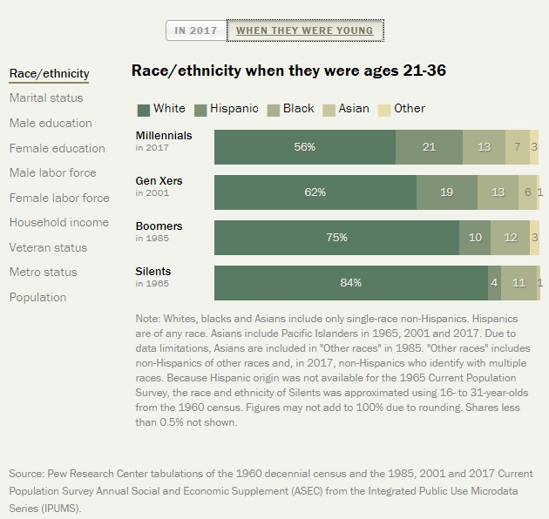
Millennials’ Traits

Slide 8
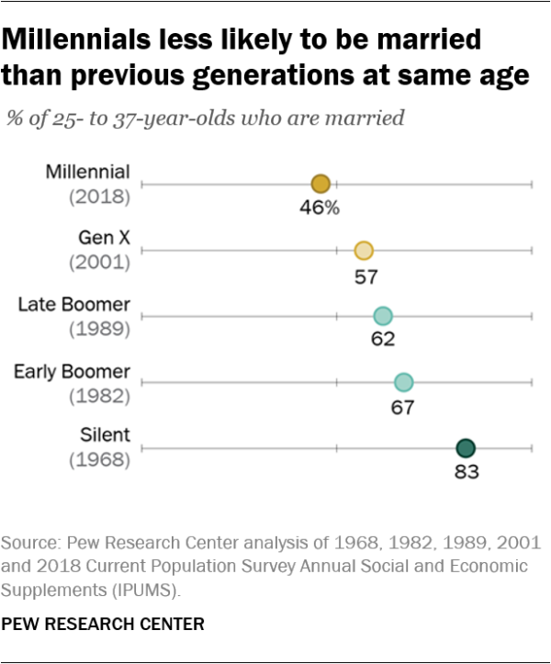
Millennials’ Traits

Slide 9
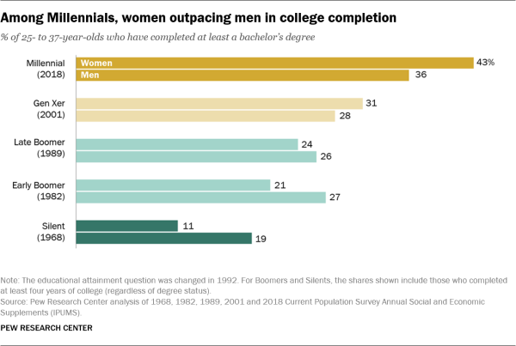
Millennials’ Traits
Notes:
https://www.pewsocialtrends.org/essay/millennial-life-how-young-adulthood-today-compares-with-prior-generations/

Slide 10
Higher Education Levels Come With Growing Debt Load

Slide 11
Millennials’ Traits

Slide 12
Millennials’ Traits

Slide 13
Millennials’ Traits

Slide 14
Millennials’ Traits

Slide 15
Residential and Housing

Slide 16
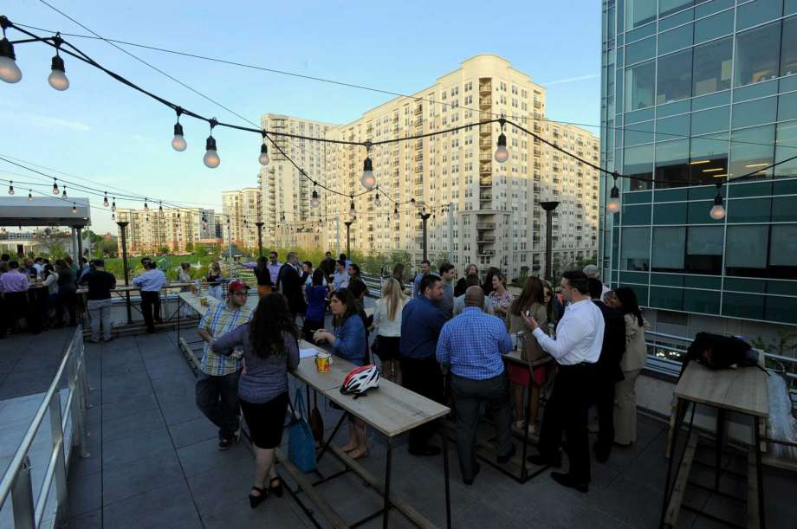
Millennials and Residential Real Estate
News reports tend to suggest that millennials are flocking to cities in droves
This re-urbanization has driven a boom in apartment construction.
A sea change in living styles, or something else?

Slide 17
Apartment Construction Booms As “Millennials Move to Cities”

Slide 18
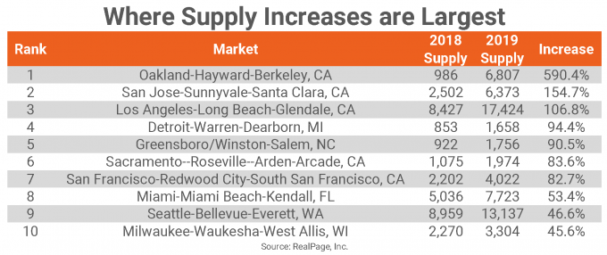
Apartment Supply Continues to Grow Above the Long Term Average
Notes:
https://www.realpage.com/analytics/scheduled-deliveries-mark-big-shifts-apartment-markets-2019/

Slide 19
And Multi-Family Cap Rates Push Multi-Decade Lows
Notes:
https://www.marcusmillichap.com/research/researchreports/reports/2019/01/28/special-report-multifamily-investment-forecast-2019

Slide 20
…But Data Doesn’t Support “Urban Millennial” Story

Slide 21
Urban Population % Declining Since Late 1980s

Slide 22
Millennials Say They Want to Own

Slide 23
Home Ownership Among Millennials Rebounding
Fannie Mae, US Census

Slide 24
Only Slightly More Likely to Purchase in Urban Areas

Slide 25
Growing Number of Multigenerational Households
Notes:
http://www.pewresearch.org/fact-tank/2018/04/05/a-record-64-million-americans-live-in-multigenerational-households/

Slide 26
Residential Trends
Moving back to downtown
Postponing first time home purchases
Living in their parents basements
Quality-of-life living expectations
Entertainment
Recreation
Cultural amenities
Authenticity

Slide 27
How Millennials Impact Manufacturing and Industrial Property Values?
Continued rise of E-commerce re-shaping supply chains and demand for both type and location of warehouses
Lower Demand for Manufacturing Jobs
thus lower demand for rusty manufacturing property
Migration back to cities (residential impact)
Reuse/redevelopment of old industrial properties
New uses for and users of industrial properties
Higher tech, unusual industrial/ manufacturing,
as well as the basics
Data Centers
Marijuana Production

Slide 28
How Millennials Impact Manufacturing and Industrial Property Values?
Their impact on other types of Property will lead impact on Man/Ind Properties
Residential
Variety of housing styles
Migration back to/residing in cities
Aging before buying first home
Retail
Online, not in-store shopping
Office
Less likely to work in traditional company or office

Slide 29
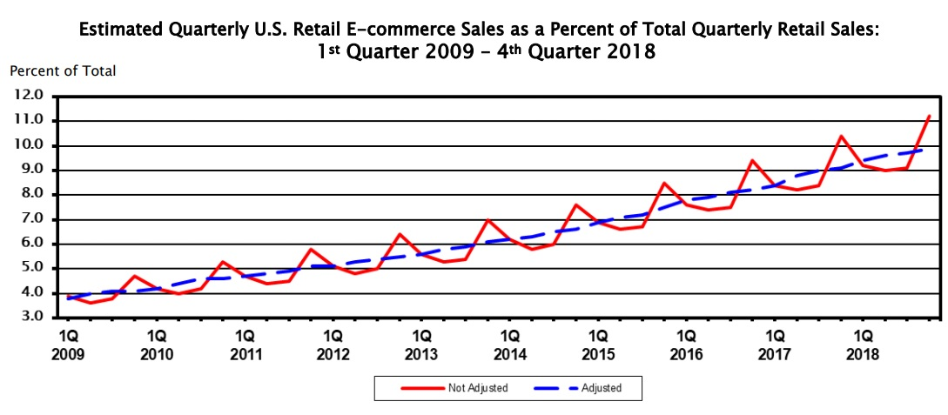
Digital Natives Drive Shift to E-Commerce
US Census Bureau

Slide 30
Digital Natives Drive Shift to E-Commerce

Slide 31
E-Commerce Changing Warehouse Demand
Online retail requires 3x the distribution center space of traditional brick and mortar
Multi-story warehouses, which exist in places like Japan and Singapore, coming to the US
Ideal warehouse locations are increasingly located closer to cities

Slide 32
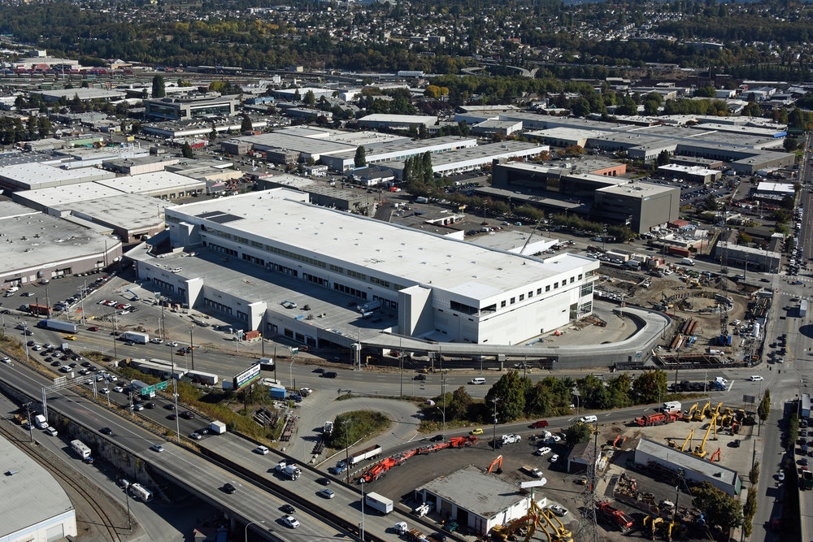
Prologis Opened Multistory Warehouse in 2018
Three floor, 590,000 square foot located outside Seattle
First of its kind in the US

Slide 33
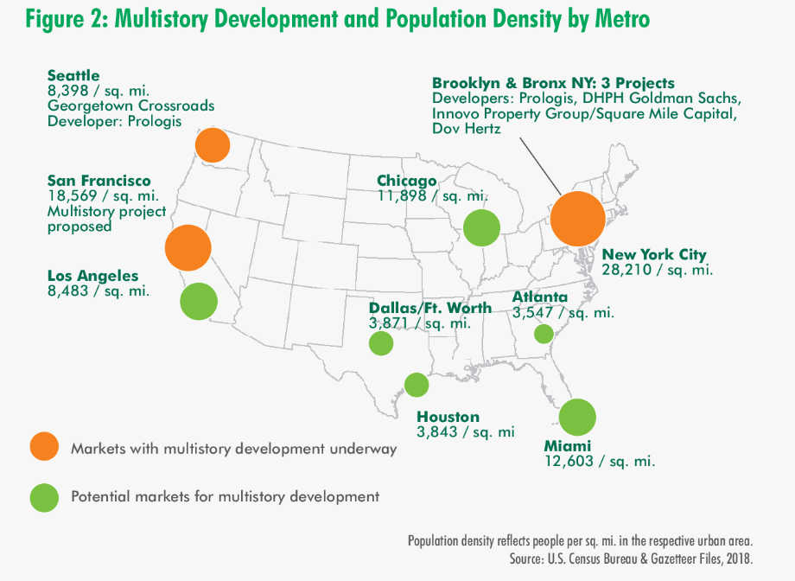
San Francisco and New York City also have multistory warehouses under construction.

Slide 34
E-Commerce Industrial Real Estate Valuation Implications
Demand for more modern facilities
Shift in locational preferences
Increased costs for multistory construction of warehouses

Slide 35
Shift to E-Commerce Drove Spike in Retail Store Closings in 2017

Slide 36
Which Continued in 2018
Notes:
https://nordic.businessinsider.com/stores-closing-this-year-2019-2/

Slide 37
And into 2019
Notes:
https://www.businessinsider.com/stores-closing-this-year-2019-2

Slide 38
Malls Must Focus on Experience, Seek New Tenants
Atlanta, Georgia
General Growth Properties

Slide 39
Introducing the Millennial Mall

Slide 40
New Economic Sectors
Data Centers
Recreational Marijuana

Slide 41
Digital Natives Also Drive Demand For Data Centers
Data centers are large buildings housing hundreds of networked servers.
Large users of electricity, the facilities typically require reinforced floors and have backup power generation on site
Google Server Room

Slide 42
Data Center or Manufacturing Facility?
Cooling towers to chill water used to cool the server rooms in Google’s Council Bluffs, Iowa data center

Slide 43
Google Repurposing Industrial Sites Across the US…
Dec 2015 – Google data center to replace Hemlock Semiconductor in Clarksville, TN
June 2015 - Google to build $600 million data facility at TVA Widows Creek Fossil Plant, AL
Sept 2013 – Google buys former Gatorade Manufacturing plant in OK
TVA Widows Creek

Slide 44
…And Its Not Just Google
Austin Business Journal
FastCompany.com
DataCenter Dynamics

Slide 45
…And Its Not Just Google
DataCenter Dynamics
Imperial Realty Company

Slide 46
…And its Not Just the US
TheStack.com
CoStar

Slide 47
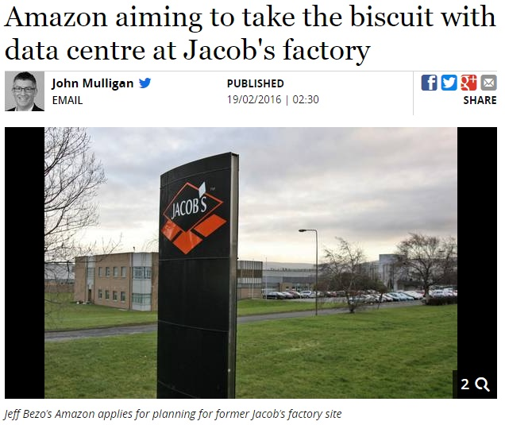
…And its Not Just the US
Irish Independent

Slide 48
Data Center Valuation Implications
Highest and Best Use
Real vs Personal Property
Purchase price + $ invested into property =/= market value?
EG.
Warehouse = $50 psf
Data Center = $500 psf

Slide 49
A New, Greener Use of Industrial Space
Notes:
https://disa.com/map-of-marijuana-legality-by-state

Slide 50
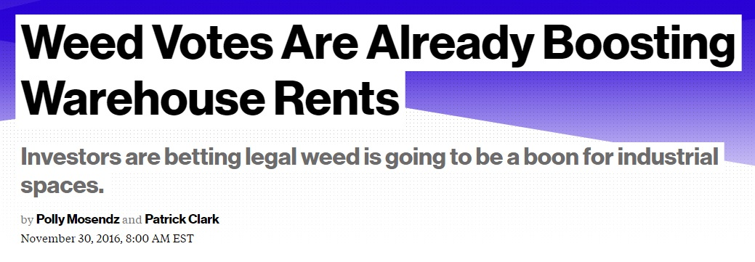
Marijuana Cultivation Starting to Crowd Out Standard Industrial Users?
Colorado & Washington legalized recreational marijuana in 2012
Voters in Massachusetts, Maine, California, and Nevada approved legalization in November 2016
Several other states could legalize in 2019, including NJ, NY, RI, CT
Bloomberg
Denver Post
WSJ

Slide 51
Marijuana Cultivation Offers Potential for Hundreds of New Industrial Users

Slide 52
Colorado Has Seen Rapid Growth in New Real Estate Demand
Number of Colorado Marijuana Licensees
 | As of 4/1/2019 | 1 Year After Legalization | % Change
Growing Operations | 703 | 419 | 68%
Manufacturing Operations | 282 | 98 | 188%
Retail Stores | 563 | 322 | 75%
Total Recreational Locations | 1548 | 839 | 85%

Slide 53
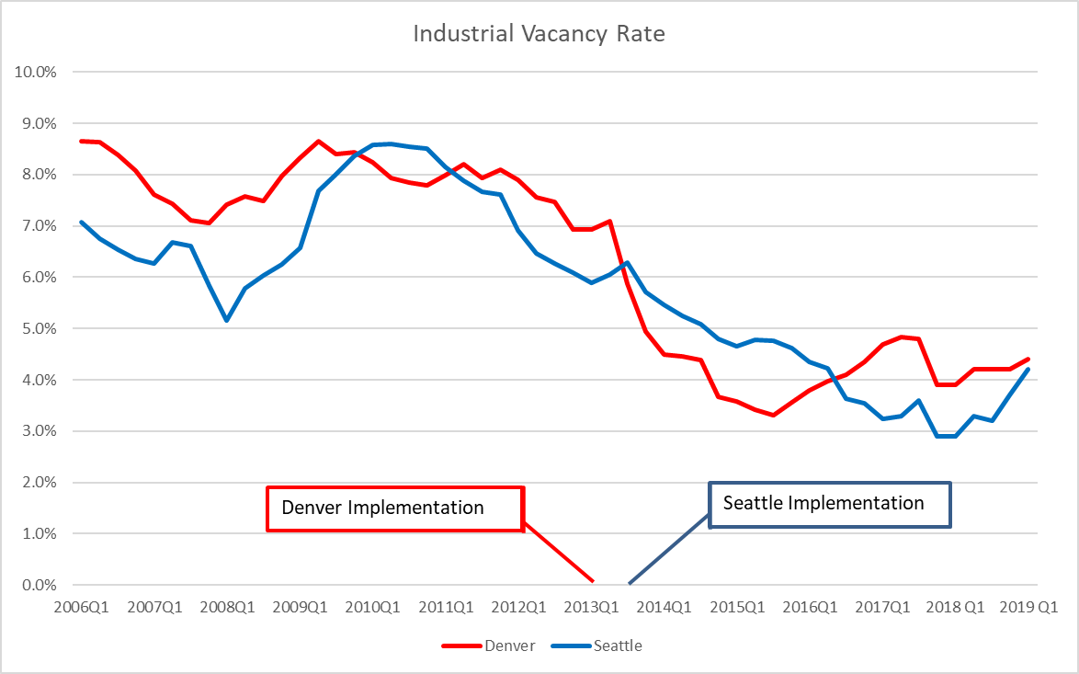
Impact on Industrial Vacancy Rates

Slide 54
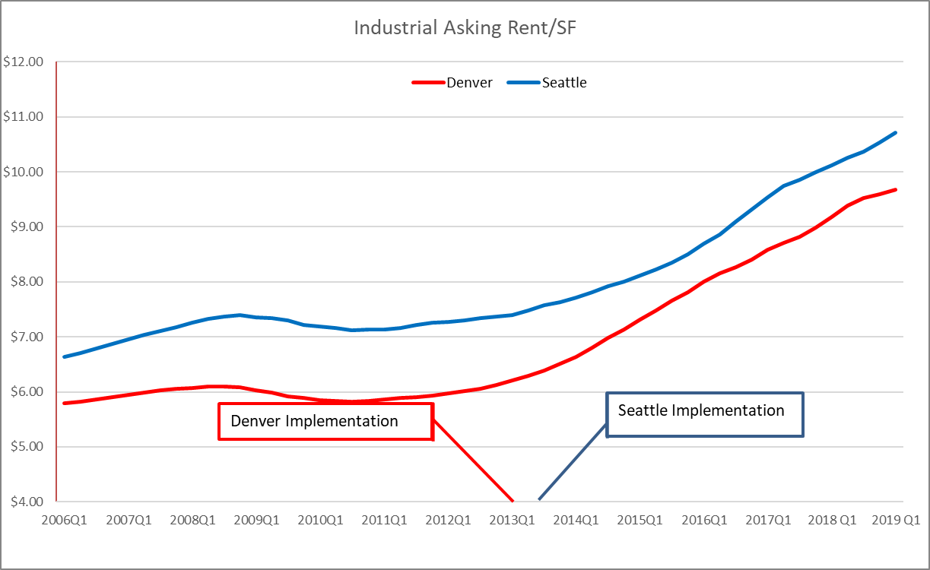
Impact on Industrial Asking Rents

Slide 55
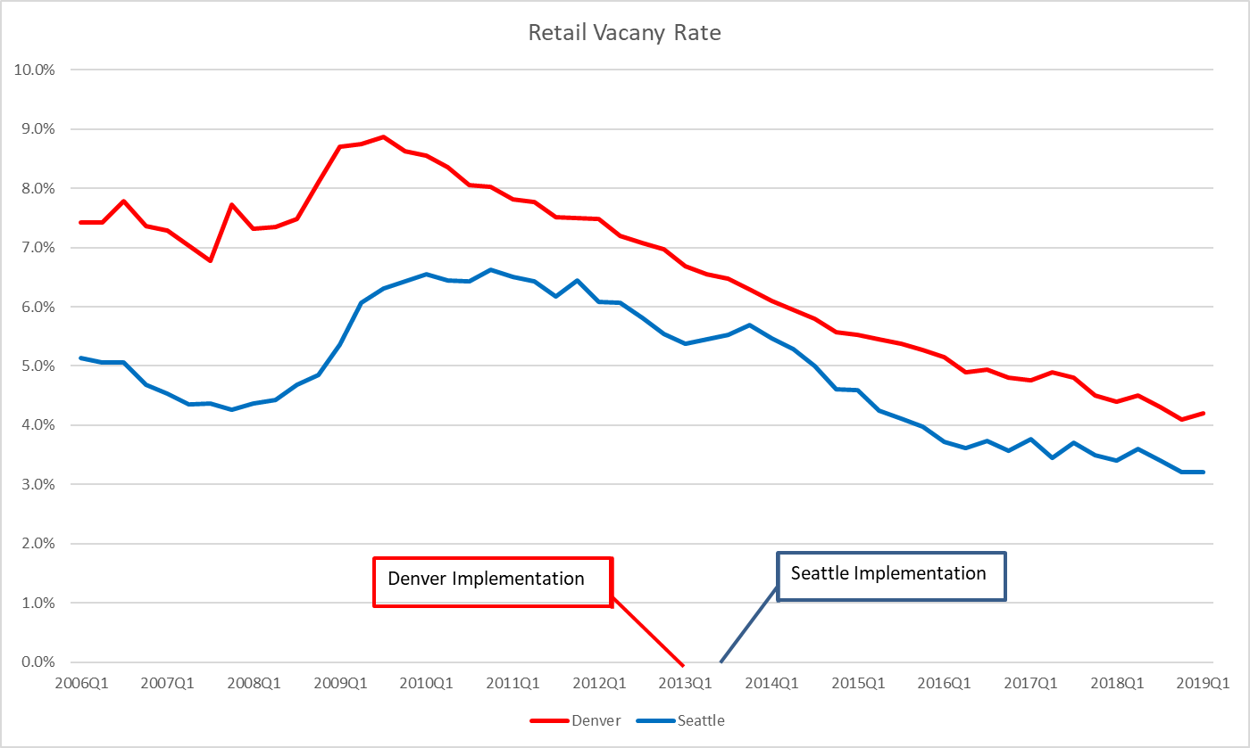
Impact on Retail Vacancy Rates

Slide 56
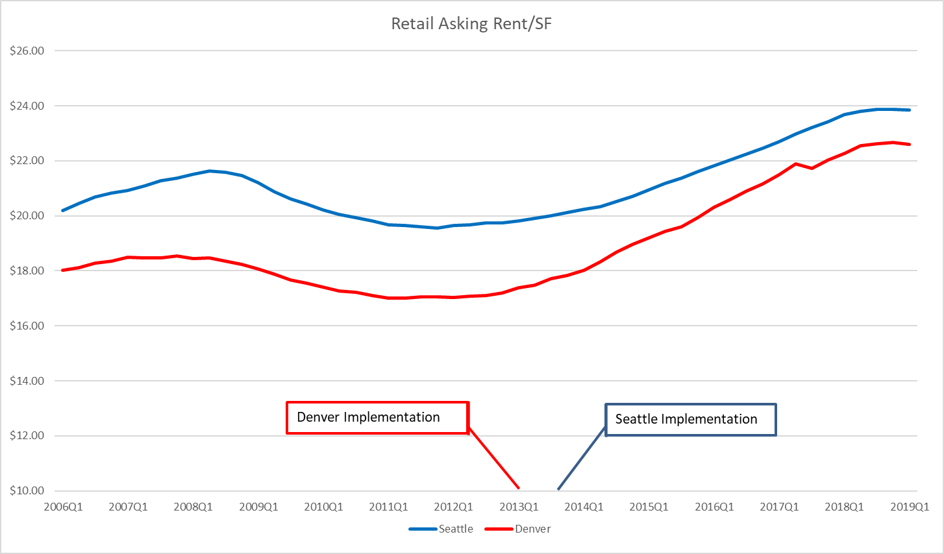
Impact on Retail Asking Rents

Slide 57
Marijuana Real Estate Valuation Implications
Real vs Personal Property
Increased rental rates
Lower vacancy rates
Risk: Longevity of the industry
Impact of conversions longer term

Slide 58
Conclusions
Millennials
Are a huge demographic and are very diverse
Have wider ranging needs
Will force change more quickly than historically
Real estate will need to adapt
Appraisers will need more sophistication to understand the complexity of the demographic trends and value.

