Slide 1
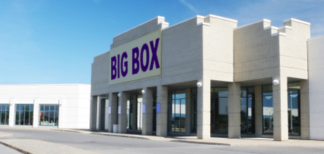



Dark Store vs the Force of Market Valuexxx
New Jersey Seminar of the Society of Professional Appraisers
Mark Pomykacz, MAI, MRICS

Slide 2
Federal Appraisal & Consulting LLC
Provides real estate and business appraisal and advisory services, nationally and internationally, concerning conventional and non-traditional appraisal issues.
  Conventional Commercial Real Estate
  Power Plants and Fuels Refineries
  Utilities and Special Purpose Properties
  Development, Acquisition/Disposition
  Tax (i.e. Property Tax), Accounting, or Audit
  Litigation and Expert Testimony
  Financing & Feasibility
  Investor Reporting

Slide 3
Mark Pomykacz, MAI, MRICS
Managing Partner – Federal Appraisal & Consulting, LLC
  Whitehouse Station, NJ
30 years appraising
Appraisal Specialties = Special Properties
  Power Plants
  Fuel Refineries
  Transmission Systems
  Water Companies
  Rail Roads
  Telecommunications
  General Commercial Real Estate
MAI, AI-GRS Appraisal Institute
MRICS, Member of the Royal Institution of Chartered Surveyors
State Certified General Real Estate Appraiser, multiple states

Slide 4
Chris Olmsted
Senior Manager – Federal Appraisal & Consulting, LLC
  Whitehouse Station, NJ
9 years appraising
Appraisal Specialties = Special Properties
  Power Plants
  Fuel Refineries
  General Commercial Real Estate
State Certified General Real Estate Appraiser, multiple states

Slide 5

Dark Store v the Force of Market Value

Slide 6
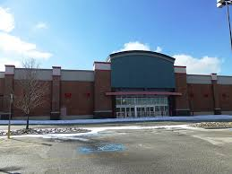
What’s a Dark Store
Two different meanings
A shop or warehouse which is only used by staff and not by customers and is intended for storing goods for purchase online.
A retail building, vacant
or hypothetically vacant
for the purposes of a
market value appraisal

Slide 7
What’s a Dark Store
No Authoritative Definition
A simple box
  Big Box, 100,000 to 200,000 sf - Walmart, Lowes, Best Buy
  Junior Box 10,000 to 50,000 sf - Rite Aid, Staples
  Single story, but tall ceiling height
  No/few windows, No/few embellishments
  Stand Alone/Free Standing
  Plain vanilla,… except for branding
  Dark: Vacant, … or assumed to be vacant
  If simple, why so much dispute
    Cost approach is simple,…until obsolescence adjustments

Slide 8
Stores Subject to Dark Store Issues
Big Boxes
Junior Boxes
50,000 to 200,000 sf, +/-
Relatively simple design
  Windowless box, 1 story
Variety of Merchandise
  Department Stores
  Category Killers
Walmart, Target, Ikea, Lowes, Costco, Dicks Sports, Best buy etc.
Less than 50,000 sf, +/-
Relatively simple design
  Windowless box, 1 story
Large Number of Items in Stock
  Category Killers
Rite Aid, Staples, Payless, Pier 1, Sleepy’s, Pep Boys.

Slide 9
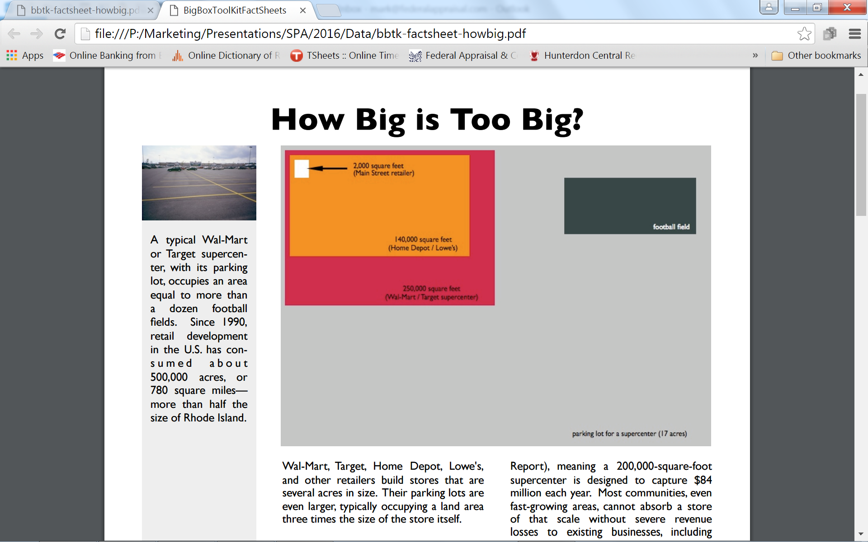
Relative Size
10,000 square feet (CVS)
Source: FAC and ilsr.org

Slide 10
The Issue
Retail properties being classified or misclassified as obsolete general purpose retail properties
  A Lowes has obsolescence because Home Depot and Ace Hardware have no value for blue colored finishes.
  A CVS has obsolescence because other general retailers (banks, liqueur store, auto parts store, clothes store) will not value CVS’s improvements, designs, and finishes.
Generally:
  General purpose property being classified or misclassified as obsolete special purpose properties, or
  Special purpose property being classified or misclassified as obsolete general purpose properties.

Slide 11
The Reasons for the Debate
Big/Junior boxes are becoming obsolete because of on-line sales.
The analysis of a specific retail operation is a value in use, not a value in exchange, i.e. market value for tax assessment.
Only vacant sales are comparable to subject’s highest and best use. Only vacant sales are appropriate basis for appraisal of fee simple, value in exchange, i.e. market value for tax assessment value.
Improvements made for one specific user are valueless to others.
Sale leasebacks are not indicative or probative of fee simple, value in exchange, i.e. market value for tax assessment.

Slide 12


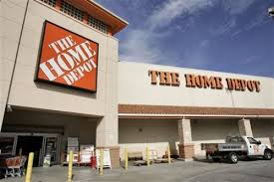
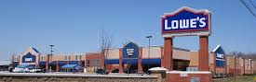
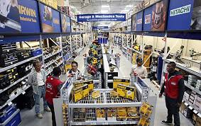
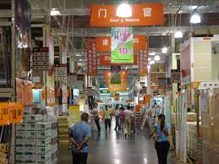
Lowes v Home Depot

Slide 13
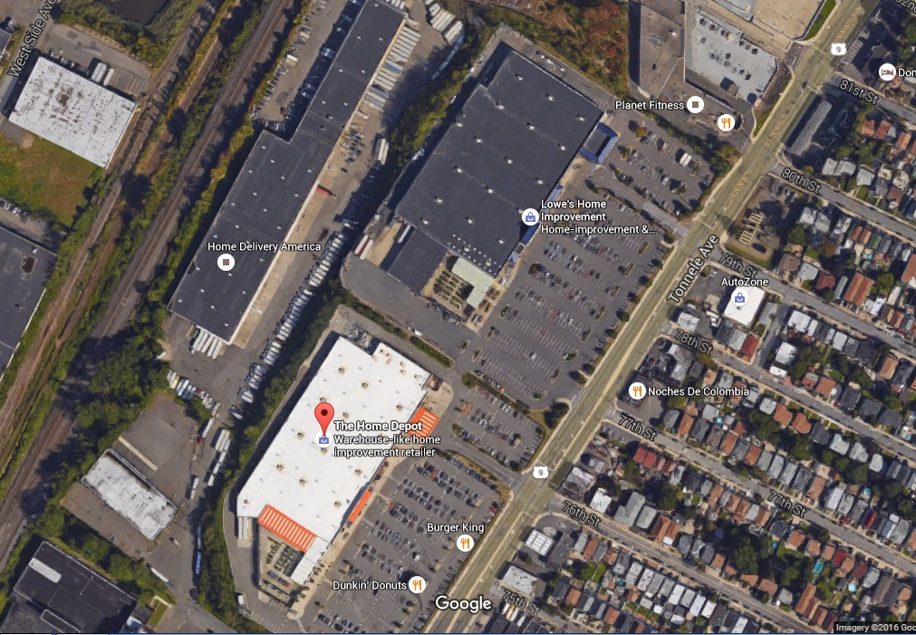
What’s the difference?
Notes:
North Bergen, NJ

Slide 14
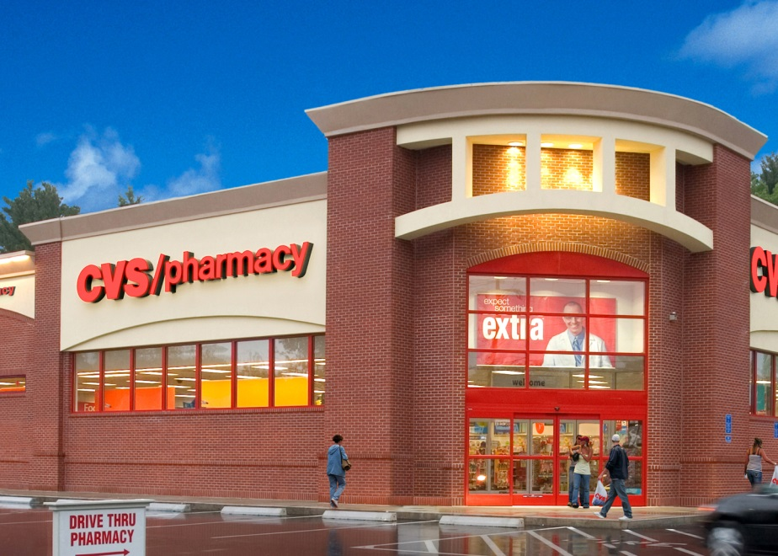
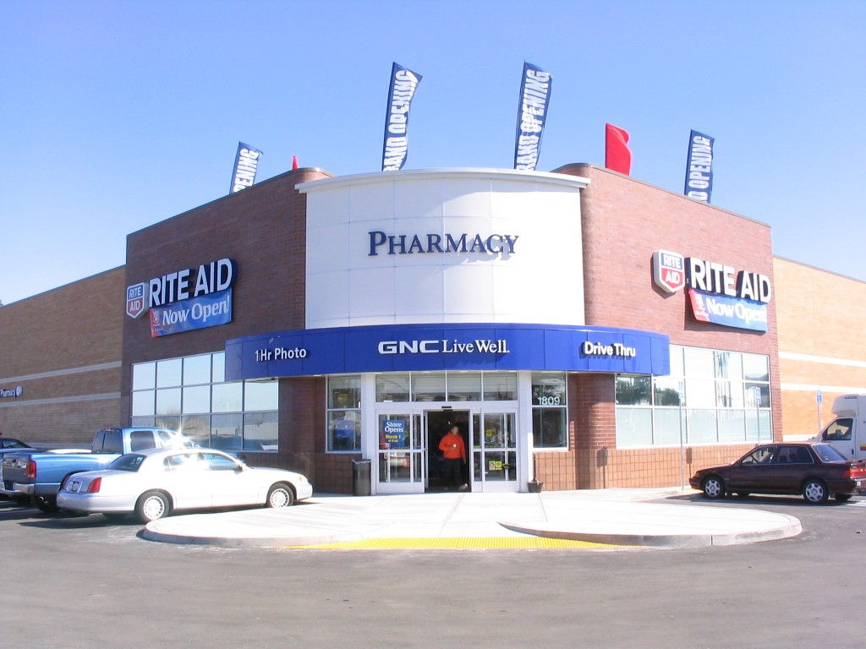
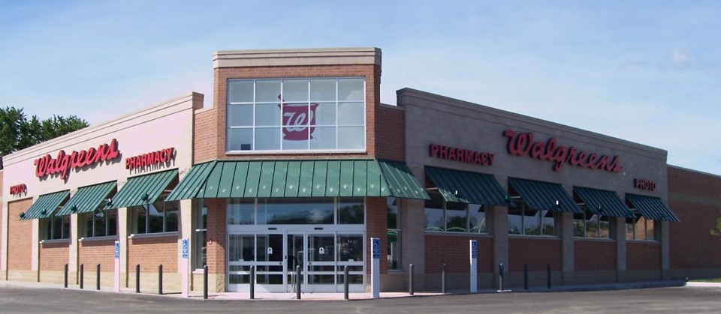
CVS vs. Rite Aid vs Walgreens

Slide 15
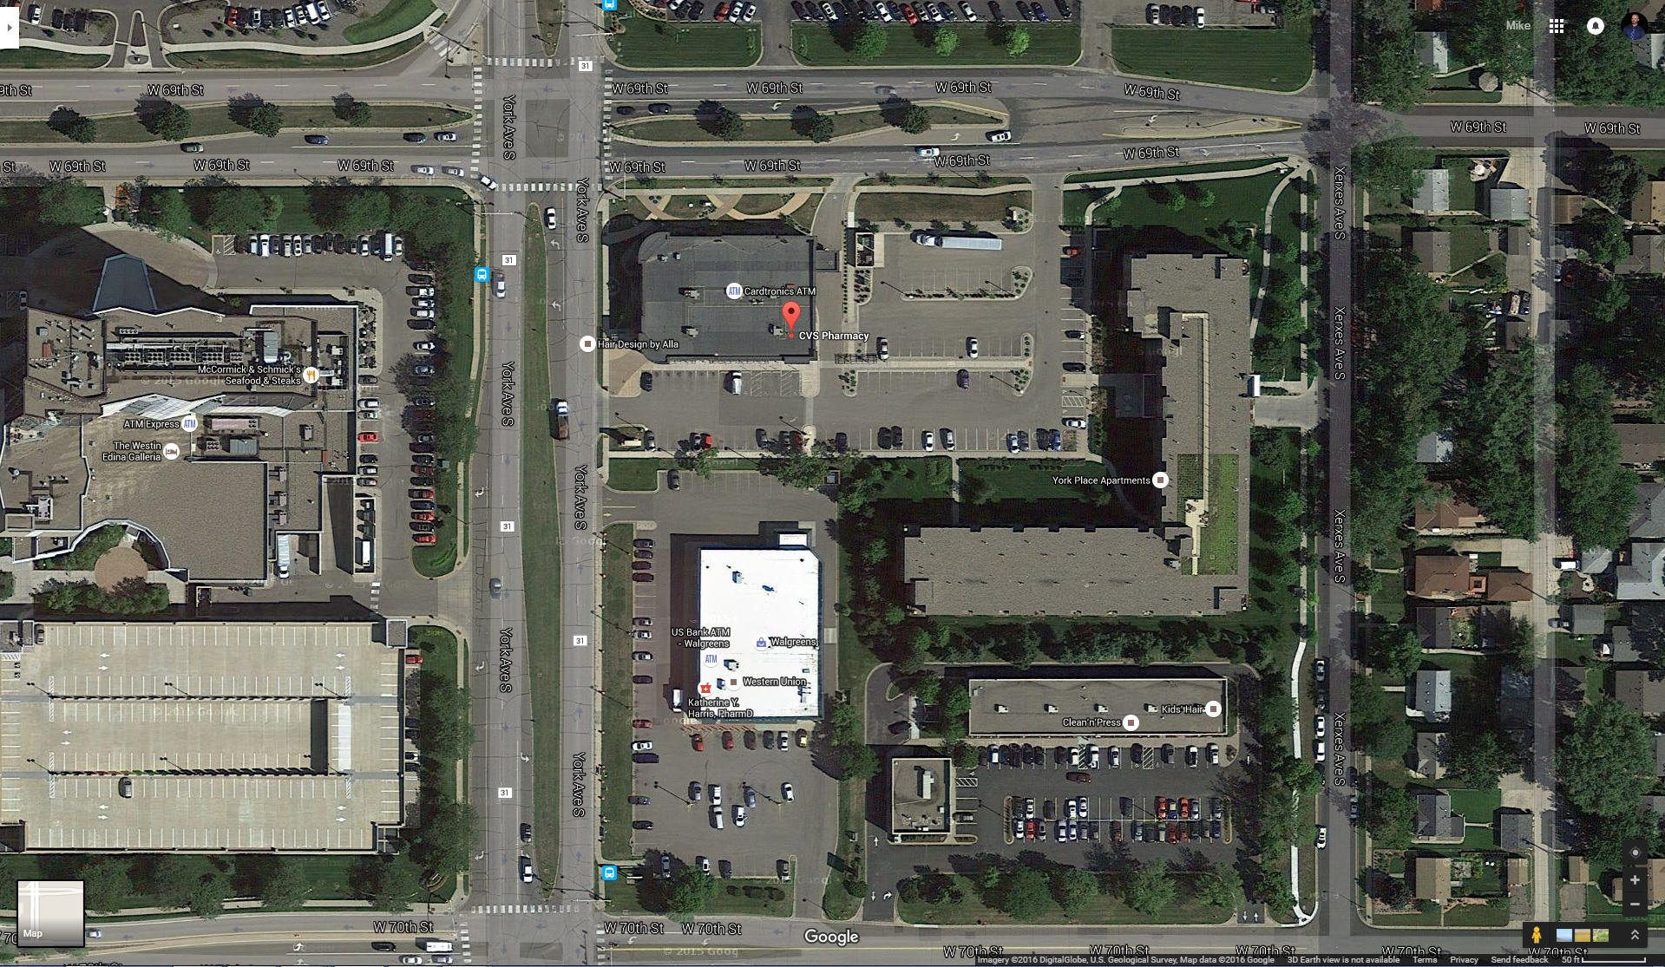
What’s the Difference?
Notes:
Edina, MN

Slide 16
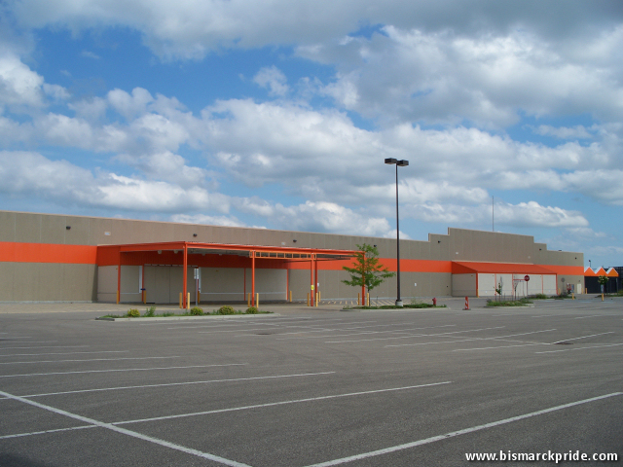
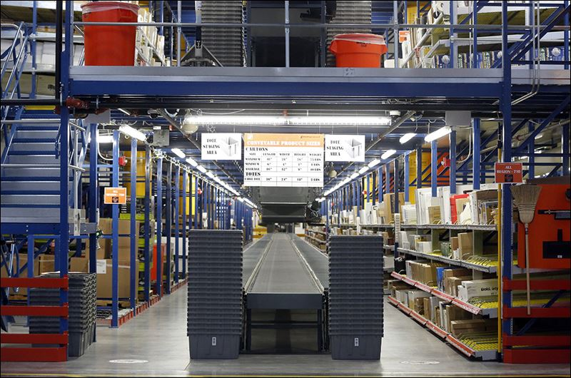
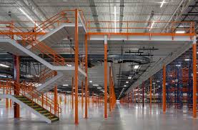
Home Depot in the News
Sold old Home Depot: http://www.bismarckcafe.com/blogs/3256/home-depot-buildings-buyers-come-forward
Home Depot Warehouse: http://www.toledoblade.com/local/2015/09/19/Huge-Home-Depot-warehouse-open.html
Home Depot Warehouse: http://builtfromscratch.homedepot.com/ohio-direct-fulfillment-center-opens/

Slide 17
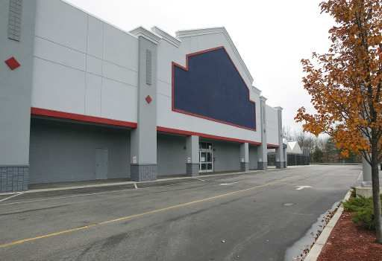
Lowes in the News
Vacant Lowes:
http://www.eagletribune.com/news/haverhill/southwick-eyes-move-to-vacant-lowe-s-building-in-haverhill/article_fddd37cb-727c-5aeb-b5f0-3426b263c210.html

Slide 18
Example #1
Imagine a vacant building.
Now determine whether the building:
  Suffers no obsolescence and has adequate demand, or
  Suffers obsolescence or inadequate demand, or both.
If vacant, but functional and in demand, vacancy is not a dramatic detrimental condition. Vo = $xx psf
If vacant, but dysfunctional and/or not in demand, vacancy is a dramatic detrimental condition. Vo = $xx psf

Slide 19
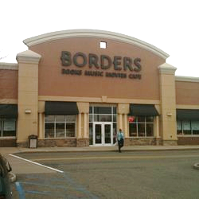
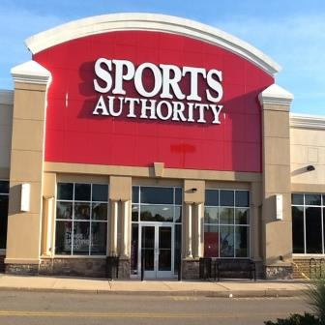
Example #1 Vacant, but in demand

Slide 20
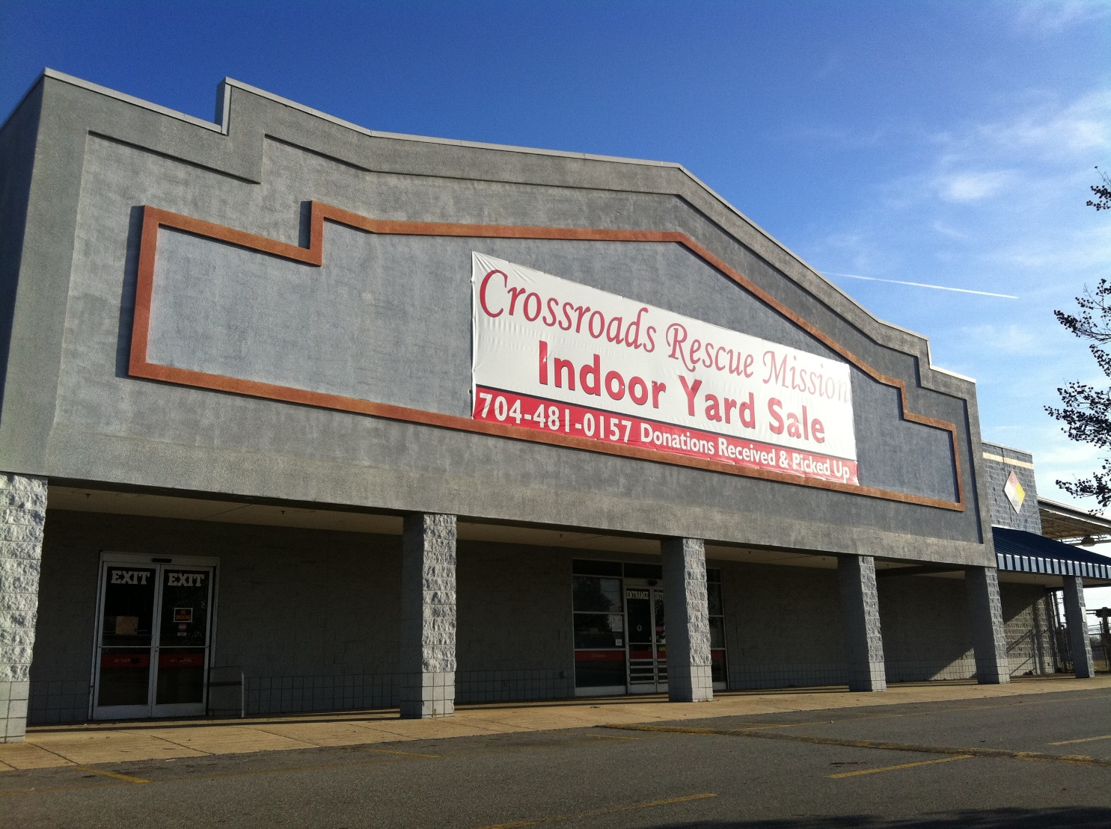
Example #2 Vacant, and not in demand
Deed Restrictions???
Vacant Lowes: https://commons.wikimedia.org/wiki/File:Former_Lowes_Shelby,_NC_(6936819239).jpg

Slide 21
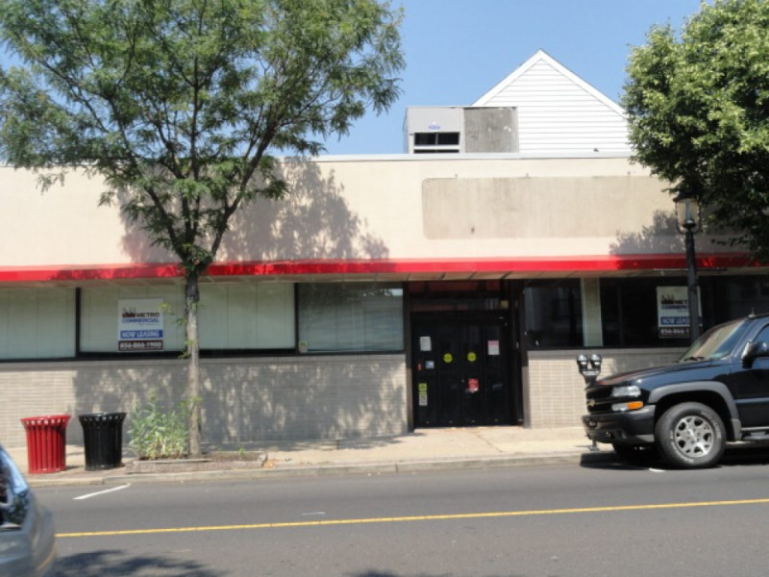
CVS in the News
http://patch.com/pennsylvania/horsham/vacancy-former-cvs

Slide 22
Example #3
Imagine an Occupied Building,
  Occupied by the original occupant, who is the developer and owner
  Who reports that the store is preforming as expected
  But the building has special improvements, which no other owner or tenant or occupant would value.
Either,
The building has a special improvement that would make it a special purpose property for assessment purposes, or
The building suffers functional or economic obsolescence.

Slide 23
Examples’ Appraisal Problem
Remember that premise of appraisal – assume the circumstances of a hypothetical “sale”.
Imagine a sale of an occupied building but one that is assumed to be vacant.
Now determine whether the building:
  Suffers no obsolescence and has adequate demand.
  Suffers obsolescence or inadequate demand, or both.
If vacant, or assumed to be, but functional and in demand, vacancy is not a dramatic condition.

Slide 24
Trends in Retail
In-Store v. Online sales – stores still account for most of sales, but declining.
Diversification of store models/types
  Bigger isn’t always better. Sometimes medium and junior boxes are best.
  But big boxes still viable.
  On-line retailers are now opening stores
Generally retail real estate is matured real estate market
  Some markets are over supplied. Few are under supplied.
  Some properties are aged to point of being uncompetitive.
  Some properties have evolved to suffer functional obsolescence
  BUT not all. Some are doing well; usually the newer ones

Slide 25
E-commerce Sales Are a Small Percent of Total Sales
Census Bureau data shows that e-commerce sales are still <10% of total US Retail Sales
Q4 2014 E-commerce sales were $89.1 billion compared to total Retail Sales in the period of $1,184.8 billion.

Slide 26
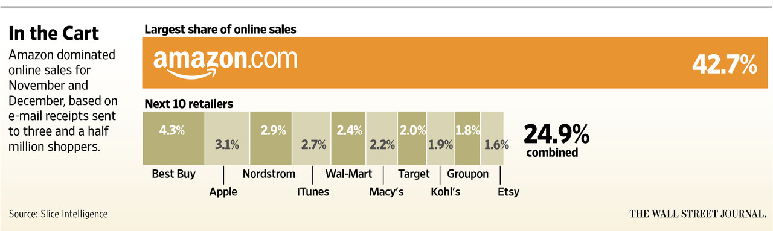
Traditional Big Box Retailers Are Small E-Commerce Players
Amazon dominates online sales, outpacing national big box stores in online sales by a huge margin.
For the 2015 holiday season, Amazon was responsible for 42.7% of online sales.

Slide 27
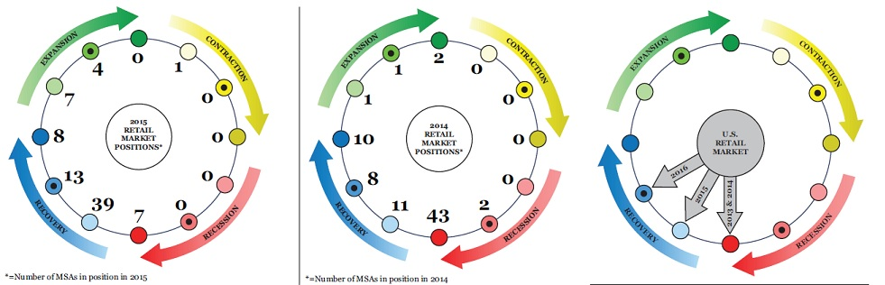
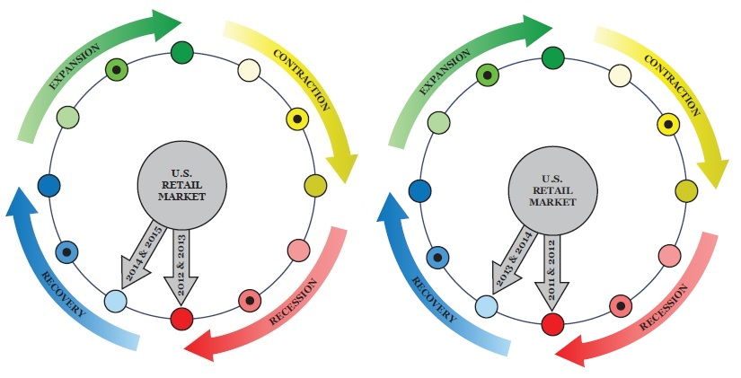
PWC Retail Market Cycle Report
2015
2014
2013
2012
2011

Slide 28
Table of Stores Planned
 |  | Typical Footprint
Concept | Credit Rating | Min SF | Max SF | Lease Term (years) | # of Stores | Planned Stores
CVS | A2 | 12,000 | 18,000 | 25 | 7,897
Fred's | B2 | 15,000 | 19,000 | 15 | 658
Rite Aid | D2 | 11,000 | 17,000 | 25 | 4,561 | 11
Walgreens | B1 | 12,000 | 17,000 | 25 | 8,173 | (200)
Total |  |  |  |  | 21,289 | (189)
 |  | Typical Footprint
Concept | Credit Rating | Min SF | Max SF | Lease Term (years) | # of Stores | Planned Stores
BJ's Wholesale | B | 85,000 | 125,000 | 20 | 210
Cabelas | A2 | 100,000 | 125,000 | 20 | 68 | 6
Costco | B1 | 145,000 | 160,000 | 20 | 487 | 19
Home Depot | A2 | 100,000 | 110,000 | 20 | 1977
Lifetime Fitness | NR | 100,000 | 125,000 | 10 | 118
Lowe's | B1 | 100,000 | 120,000 | 20 | 1849 | 45
Meijer | NR | 180,000 | 210,000 | 20 | 223 | 9
Menards | NR | 100,000 | 130,000 | 20 | 280
Sam's Club | AA | 120,000 | 150,000 | 20 | 655 | 7
Target | B1 | 85,000 | 150,000 | 20 | 1792 | 13
Walmart | A2 | 125,000 | 160,000 | 20 | 4574 | 38
Wegman's | BBB+ | 120,000 | 140,000 | 20 | 88 | 4
Total |  |  |  |  | 12,321 | 141

Slide 29
Foundational Concepts in Dark Stores
Market Value
  Market Value assuming a Hypothetical Sale
    As occupied
    As if vacant
    By original or next generation occupant
Highest and Best Use
    As occupied
    As if vacant
    By original or next generation occupant
Value in Exchange versus Value in Use
Property Rights Appraised
Special Purpose Property

Slide 30
Market Value – Basis of Assessment
Market Value - The most probable price that the specified property interest should sell for in a competitive market after a reasonable exposure time, as of a specified date, in cash, or in terms equivalent to cash, under all conditions requisite to a fair sale, with the buyer and seller each acting prudently, knowledgeably, for self-interest, and assuming that neither is under duress.
  Source: Appraisal Institute, The Dictionary of Real Estate Appraisal, 5th ed. (Chicago: Appraisal Institute, 2010).
Market Value = Value in Exchange

Slide 31
Value in Use v. Value in Exchange
value in exchange - Attribution of value to goods or services based on what can be obtained for them in exchange for other goods and services.
value in use - The value of a property assuming a specific use, which may or may not be the property’s highest and best use on the effective date of the appraisal. Value in use may or may not be equal to market value but is different conceptually.
Source: Appraisal Institute, The Dictionary of Real Estate Appraisal, 5th ed. (Chicago: Appraisal Institute, 2010).

Slide 32
Market Value v Value in Use
value in use - The value of a property assuming a specific use, which may or may not be the property’s highest and best use on the effective date of the appraisal.
Market Value - The most probable price that the specified property interest should sell for in a competitive market after a reasonable exposure time, as of a specified date, in cash, or in terms equivalent to cash, under all conditions requisite to a fair sale, with the buyer and seller each acting prudently, knowledgeably, for self-interest, and assuming that neither is under duress.

Slide 33
Highest and Best Use
The reasonably probable and legal use of vacant land or an improved property that is physically possible, appropriately supported, financially feasible, and that results in the highest value. The four criteria the highest and best use must meet are legal permissibility, physical possibility, financial feasibility, and maximum productivity.
  Source: Appraisal Institute, The Dictionary of Real Estate Appraisal, 5th ed. (Chicago: Appraisal Institute, 2010).

Slide 34
Highest and Best Use
Required for Determination of Market Value
Must be a “Reasonably Probable” Use
  Most likely use
  Most likely user or group of users

Slide 35
Property Rights Appraised
Property Taxation – Fee Simple, full bundle of rights
  If highest and best use is for leasing out property, then
    Immediately assume leased up to stabilized levels, or
    Assume a lease up period, before stabilization?
    Either case assumes leased fee.
Deed Restrictions do not grant full bundle of right, not true fee simple
  Should or should not be considered?

Slide 36
Special Purpose Property
A property with a unique physical design, special construction materials, or a layout that particularly adapts its utility to the use for which it was built; also called a special-design property.
Limited Market Property – A property (or property right) that has relatively few potential buyers.
Source: Appraisal Institute, The Dictionary of Real Estate Appraisal, 6th ed. (Chicago: Appraisal Institute, 2015).
So, even if a Big/Junior Box has no other users than the current one,
  Then it is not necessarily proof of obsolescence,
  but rather proof of its special purpose / limited market status,
  And then it should be assessed as special purpose property.

Slide 37
Misperceptions over Concepts
Five areas of debate

Slide 38
Misperceptions over Concepts, 1
Four criteria in H&BU – No, there’s really five
  Physically possible
  Legal
  Financially feasible
  Maximally productive
  Reasonably probable

Slide 39
Highest and Best Uses and Users
Big/Junior Box Retailers
  First Generation versus Second Generation
    Used as designed and planned
    Used alternatively to original intent
  Owner Occupants versus Investors/Landlords with Tenants
  Developers versus Buyers
Redevelopers
    Of Improvements or of the land
Second Generation
  Subject to functional obsolescence and/or economic obsolescence.

Slide 40
Misperceptions over Concepts, 2
Market Value
  Price that should “sell for”. No, should “sell, build or rent for”, or should “transact for”
    Otherwise, our fundamental principles underlying the three approaches are without merit.
      “sell” = Sales Approach
      “build” = Cost Approach
      “rent” = Income Approach
    Otherwise, for example, special purpose property, which has only one user, which thus can never find another buyer, but for which the current owner, and user, who built it and who finds full utility in it, would have No market value.
    Most Probable Value

Slide 41
Misperceptions over Concepts, 3
“No one but the current user values the property. Therefore economic and/or functional obsolescence.”
  Even if only one user values a property, then the property has value, and the property’s value is based on that use.
    The property is a special purpose property, as historically defined in property tax law
  Conversely, if we are to classify retail property that only a few or one user value, as economically and/or functionally obsolescence, then nearly all property types have economic and/or functional obsolescence.
    Eg. SFH with unpopular paint, designs, or finishes

Slide 42
Misperceptions over Concepts, 4
“Hypothetical Sale”
  Market Value is that price that would be in a hypothetical sale
  Some argue that Hypothetical Sale assumes property is vacant at time of sale
“Hypothetical Sale” is short hand, a mental construct, not intended to exclude other perspectives
  Should be “Hypothetical Transaction”
    Hypothetical Sale, Hypothetical Rental, Hypothetical Cost
  Should use market vacancy, for fee value
  Need not assume lease up costs for occupied buildings

Slide 43
Image Three Properties
Property 1 2 3
Class/Type: Identical Identical Identical
Status: Owner Tenant Vacant
Occupied Occupied
Maximally Owner Tenant or Owner or
Productive User: Occupant Investor Investor
Appraisal Stabilized Stabilized Lease Up
Assumptions: Vac, Cap Ex Vac, Cap Ex All Lease-up

Slide 44
Value in Use/Value in Exchange Relationship, 1
Universe of Users and Types of Users for Store X
All Others
Jane’s Jewelry
Jake’s Liquors
Joe’s Pizza
JJ’s Electronics
Jeanne’s Clothes

Slide 45
Value in Use/Value in Exchange Relationship, 2
Universe of Users and Types of Users for Store Y
All Others
Big Box User or Type #2
Big Box User or Type #1
Big Box User or Type #3

Slide 46
Value in Use/Value in Exchange Relationship, 3
Histogram
Now, apply appraisal judgement to find Value in Exchange
Probable users. Thus, the basis of Value in Exchange, e.g. Market Value
Count of Users/User Types
Value in Use by User/User Type

Slide 47
What’s taxable and what’s not?
  Special Improvements may be Fixture, Furnishings or Equipment
    Signs
    Displays
    Branding Ornamentation

Slide 48
Cost Approach
Type of Facility | Big Box Retail | Junior Box Drug Store
Data Source | MVS | MVS
Valuation Date | 1/1/2016 | 1/1/2016
Base Costs | $64.70 | $117.42
Current Cost Multiplier | 1.00 | 1.05
Local Multiplier | 1.00 | 1.00
Total Cost PSF 2015 | $64.70 | $123.29
Square Footage | 150,000 | 10,000
Replacement Cost New | $9,705,000 | $1,233,000
Entrepreneurial Profit (%) | 15% | 15%
Replacement Cost New plus Entrepreneurial Profit | $11,160,750 | $1,417,950
Effective Age And Normal Useful Life
Year Placed In Service | 2015 | 2015
Depreciation | 0.00% | 0.00%
Total Physical Depreciation | $0 | $0
Replacement Cost New Less Physical Depreciation | $11,161,000 | $1,418,000
Functional and Economic Obsolescence | $0 | $0
Replacement Cost New Less Physical Depreciation and Economic and Functional Obsolescence | $11,161,000 | $1,418,000
$/SF | $74.41 | $141.80
Land Value | $3,906,350 | $709,000
Total Value Conclusion via the Cost Approach | $15,067,350 | $2,127,000
Rounded | $15,100,000 | $2,100,000
$/SF | $101 | $210

Slide 49
Sales Approach
Usable versus Disqualified Sales
Big/Junior Boxes are usually built and occupied by owner/users
Sale Leasebacks as Sales Comparables

Slide 50
Usability versus Disqualified Sales
Do not confuse disqualifying sales because of practicality versus a categorical disqualification.
In general practice, appraisers and assessors disqualify many sales, because practically speaking
  Sorting out the issues is difficult, and
  There is adequate data elsewhere.
  NJ code has 33 non-usable codes.
Sound appraisal theory says, however, nearly all sales with non-usable codes are usable, if
  Appraisers can find data to complete adjustments, and
  Appraisers complete the adjustments properly.

Slide 51
NJ Non-usable codes
18:12-1.1 Categories enumerated:
(a) The deed transactions of the following categories are not usable in determining assessment sales ratios pursuant to N.J.S.A. 54:1-35.1 et seq.:
  1. Sales between members of the immediate family;
  2. Sales in which “love and affection” are stated to be part of the consideration;
  6. Sales of property conveying only a portion of the assessed unit
  23. Sales of commercial or industrial real property which include machinery, fixtures, equipment, inventories, or goodwill when the values of such items are indeterminable;

Slide 52
NJ Non-usable codes, continued
  28. Sales of properties which are subject to a leaseback arrangement;
(b) Transfers falling within the foregoing category numbers 1, 2, 3, 9, 10, 13, 15, 17, 26, 28 and 31 (under section (a) above), should generally be excluded but may be used if after full investigation it clearly appears that the transaction was a sale between a willing buyer, not compelled to buy, and a willing seller, not compelled to sell, with all conditions requisite to a fair sale with the buyer and seller acting knowledgeably and for their own self-interests, and that the transaction meets all other requisites of a usable sale.

Slide 53
National Big Box Sales
100% Vacant / 100% Occupied

Slide 54
Income Approach
Example DCFs
Sale Leasebacks
  Net Zero Leases
Use and User Assumptions
  Original or second or third generation uses or users
Leasing Assumptions
  Stablized vacancy or lease up period

Slide 55
Example DCFs
Imagine an occupied building, utilized and intended to remain so, then functional and in demand, and market vacancy is not a dramatic detrimental condition.
  Even if there is only one user for the property
  Classic Fee Simple Value: stabilized rents and vacancy
Imagine a vacant building, but still functional and in demand, and market vacancy is not a dramatic detrimental condition.
  Reflects initial period of lease up lost income and costs
Imagine a vacant building, but dysfunctional and/or not in demand, and market vacancy is a dramatic detrimental condition.
  Reflects initial period of lease up lost income and costs
  Reflects lower market rents

Slide 56
Example DCFs
Valuation Date | 1/1/2016
Type of Analysis | DCF at Market Vacancy Rates | DCF with 3 Years Lease Up | DCF with Lower Rents
Building Square Footage | 150,000 | 150,000 | 150,000
Lease Term (Years) | 20 | 20 | 20
Lease Terms | NNN | NNN | NNN
First Year Operating Exp ($) | $100,000 | $100,000 | $100,000
Rental Rate ($/Sq.Ft.) | $10.00 | $10.00 | $5.00
Vacancy Scenario | 10% Market Vacancy | 3-year initial vacancy, then 10% market vacancy | 3-year initial vacancy, then 10% market vacancy
Inflation Rate | 2.50% | 2.50% | 2.50%
Cap Ex | 1% | 1% | 1%
Value Conclusion ($) | $18,900,000 | $13,600,000 | $6,000,000
Value Conclusion ($/Sq.Ft.) | $126 | $91 | $40
Cost Approach Value ($) | $15,100,000
Cost Approach Value ($/Sq.Ft.) | $101

Slide 57
Example #1 DCF
 | 1 | 2 | 3 | 4 | 5 | 6 | 7 | 8 | 9 | 10
 | 2016 | 2017 | 2018 | 2019 | 2020 | 2021 | 2022 | 2023 | 2024 | 2025
Gross Potential Operating Income | $ 1,500,000 | $1,537,500 | $1,575,938 | $1,615,336 | $1,655,719 | $1,697,112 | $1,739,540 | $1,783,029 | $1,827,604 | $1,873,294
Vacancy & Collection Loss | $ (150,000) | $ (153,750) | $ (157,594) | $ (161,534) | $ (165,572) | $ (169,711) | $ (173,954) | $ (178,303) | $ (182,760) | $ (187,329)
NOI | $ 1,350,000 | $1,383,750 | $1,418,344 | $1,453,802 | $1,490,147 | $1,527,401 | $1,565,586 | $1,604,726 | $1,644,844 | $1,685,965
Non-Reimbursable Operating Expenses | $ 100,000 | $ 102,500 | $ 105,063 | $ 107,689 | $ 110,381 | $ 113,141 | $ 115,969 | $ 118,869 | $ 121,840 | $ 124,886
Capital Costs | $ 15,000 | $ 15,375 | $ 15,759 | $ 16,153 | $ 16,557 | $ 16,971 | $ 17,395 | $ 17,830 | $ 18,276 | $ 18,733
Brokerage | $ 9,000 | $ 9,225 | $ 9,456 | $ 9,692 | $ 9,934 | $ 10,183 | $ 10,437 | $ 10,698 | $ 10,966 | $ 11,240
Tenant Improvements | $ 75,000 | $ 75,000 | $ 75,000 | $ 75,000 | $ 75,000 | $ 75,000 | $ 75,000 | $ 75,000 | $ 75,000 | $ 75,000
Total Expenses | $ 199,000 | $ 202,100 | $ 205,278 | $ 208,534 | $ 211,873 | $ 215,295 | $ 218,802 | $ 222,397 | $ 226,082 | $ 229,859
Adjusted Net Income | $ 1,151,000 | $1,181,650 | $1,213,066 | $1,245,268 | $1,278,275 | $1,312,106 | $1,346,784 | $1,382,329 | $1,418,762 | $1,456,106
Residual Cap Rate
Residual Expense Rate
Residual Value
Adjusted Net Income & Net Residual | $ 1,151,000 | $1,181,650 | $1,213,066 | $1,245,268 | $1,278,275 | $1,312,106 | $1,346,784 | $1,382,329 | $1,418,762 | $1,456,106
Discount Factor | 0.925926 | 0.857339 | 0.793832 | 0.73503 | 0.680583 | 0.63017 | 0.58349 | 0.540269 | 0.500249 | 0.463193
Discounted Cash Flow | $ 1,065,741 | $1,013,075 | $ 962,971 | $ 915,309 | $ 869,972 | $ 826,850 | $ 785,835 | $ 746,829 | $ 709,734 | $ 674,458
 | 11 | 12 | 13 | 14 | 15 | 16 | 17 | 18 | 19 | 20 | Residual
 | 2026 | 2027 | 2028 | 2029 | 2030 | 2031 | 2032 | 2033 | 2034 | 2035 | 2036
Gross Potential Operating Income | $ 1,920,127 | $1,968,130 | $2,017,333 | $2,067,767 | $2,119,461 | $2,172,447 | $2,226,758 | $2,282,427 | $2,339,488 | $ 2,397,975 | $ 2,457,925
Vacancy & Collection Loss | $ (192,013) | $ (196,813) | $ (201,733) | $ (206,777) | $ (211,946) | $ (217,245) | $ (222,676) | $ (228,243) | $ (233,949) | $ (239,798) | $ (245,792)
NOI | $ 1,728,114 | $1,771,317 | $1,815,600 | $1,860,990 | $1,907,515 | $1,955,203 | $2,004,083 | $2,054,185 | $2,105,539 | $ 2,158,178 | $ 2,212,132
Non-Reimbursable Operating Expenses | $ 128,008 | $ 131,209 | $ 134,489 | $ 137,851 | $ 141,297 | $ 144,830 | $ 148,451 | $ 152,162 | $ 155,966 | $ 159,865 | $ 163,862
Capital Costs | $ 19,201 | $ 19,681 | $ 20,173 | $ 20,678 | $ 21,195 | $ 21,724 | $ 22,268 | $ 22,824 | $ 23,395 | $ 23,980 | $ 24,579
Brokerage | $ 11,521 | $ 11,809 | $ 12,104 | $ 12,407 | $ 12,717 | $ 13,035 | $ 13,361 | $ 13,695 | $ 14,037 | $ 14,388 | $ 14,748
Tenant Improvements | $ 75,000 | $ 75,000 | $ 75,000 | $ 75,000 | $ 75,000 | $ 75,000 | $ 75,000 | $ 75,000 | $ 75,000 | $ 75,000 | $ 75,000
Total Expenses | $ 233,730 | $ 237,699 | $ 241,766 | $ 245,935 | $ 250,209 | $ 254,589 | $ 259,079 | $ 263,681 | $ 268,398 | $ 273,233 | $ 278,188
Adjusted Net Income | $ 1,494,384 | $1,533,618 | $1,573,834 | $1,615,055 | $1,657,306 | $1,700,614 | $1,745,004 | $1,790,504 | $1,837,142 | $ 1,884,945 | $ 1,933,944
Residual Cap Rate |  |  |  |  |  |  |  |  |  |  | 7.63%
Residual Expense Rate |  |  |  |  |  |  |  |  |  |  | 4.00%
Residual Value |  |  |  |  |  |  |  |  |  |  | $24,332,713
Adjusted Net Income & Net Residual | $ 1,494,384 | $1,533,618 | $1,573,834 | $1,615,055 | $1,657,306 | $1,700,614 | $1,745,004 | $1,790,504 | $1,837,142 | $26,217,658
Discount Factor | 0.428883 | 0.397114 | 0.367698 | 0.340461 | 0.315242 | 0.29189 | 0.270269 | 0.250249 | 0.231712 | 0.214548
Discounted Cash Flow | $ 640,916 | $ 609,021 | $ 578,696 | $ 549,863 | $ 522,452 | $ 496,392 | $ 471,620 | $ 448,072 | $ 425,688 | $ 5,624,946
Present Value | $18,900,000

Slide 58
Example #2 DCF
 | 1 | 2 | 3 | 4 | 5 | 6 | 7 | 8 | 9 | 10
 | 2016 | 2017 | 2018 | 2019 | 2020 | 2021 | 2022 | 2023 | 2024 | 2025
Gross Potential Operating Income | $ 1,500,000 | $ 1,500,000 | $ 1,500,000 | $1,500,000 | $1,537,500 | $1,575,938 | $1,615,336 | $1,655,719 | $1,697,112 | $1,739,540
Vacancy & Collection Loss | $ (1,500,000) | $ (1,500,000) | $ (1,500,000) | $ (150,000) | $ (153,750) | $ (157,594) | $ (161,534) | $ (165,572) | $ (169,711) | $ (173,954)
NOI | $ - | $ - | $ - | $1,350,000 | $1,383,750 | $1,418,344 | $1,453,802 | $1,490,147 | $1,527,401 | $1,565,586
Non-Reimbursable Operating Expenses | $ 100,000 | $ 102,500 | $ 105,063 | $ 107,689 | $ 110,381 | $ 113,141 | $ 115,969 | $ 118,869 | $ 121,840 | $ 124,886
Capital Costs | $ 15,000 | $ 15,000 | $ 15,000 | $ 15,000 | $ 15,375 | $ 15,759 | $ 16,153 | $ 16,557 | $ 16,971 | $ 17,395
Brokerage | $ - | $ - | $ 90,000 | $ 9,000 | $ 9,225 | $ 9,456 | $ 9,692 | $ 9,934 | $ 10,183 | $ 10,437
Tenant Improvements | $ - | $ - | $ 750,000 | $ 75,000 | $ 75,000 | $ 75,000 | $ 75,000 | $ 75,000 | $ 75,000 | $ 75,000
Total Expenses | $ 115,000 | $ 117,500 | $ 960,063 | $ 206,689 | $ 209,981 | $ 213,356 | $ 216,815 | $ 220,360 | $ 223,994 | $ 227,719
Adjusted Net Income | $ (115,000) | $ (117,500) | $ (960,063) | $1,143,311 | $1,173,769 | $1,204,988 | $1,236,988 | $1,269,787 | $1,303,407 | $1,337,867
Residual Cap Rate
Residual Expense Rate
Residual Value
Adjusted Net Income & Net Residual | $ (115,000) | $ (117,500) | $ (960,063) | $1,143,311 | $1,173,769 | $1,204,988 | $1,236,988 | $1,269,787 | $1,303,407 | $1,337,867
Discount Factor | 0.925926 | 0.857339 | 0.793832 | 0.73503 | 0.680583 | 0.63017 | 0.58349 | 0.540269 | 0.500249 | 0.463193
Discounted Cash Flow | $ (106,481) | $ (100,737) | $ (762,128) | $ 840,368 | $ 798,847 | $ 759,347 | $ 721,770 | $ 686,027 | $ 652,028 | $ 619,691
 | 11 | 12 | 13 | 14 | 15 | 16 | 17 | 18 | 19 | 20 | Residual
 | 2026 | 2027 | 2028 | 2029 | 2030 | 2031 | 2032 | 2033 | 2034 | 2035 | 2036
Gross Potential Operating Income | $ 1,783,029 | $1,827,604 | $1,873,294 | $1,920,127 | $1,968,130 | $2,017,333 | $2,067,767 | $2,119,461 | $2,172,447 | $ 2,226,758 | $ 2,282,427
Vacancy & Collection Loss | $ (178,303) | $ (182,760) | $ (187,329) | $ (192,013) | $ (196,813) | $ (201,733) | $ (206,777) | $ (211,946) | $ (217,245) | $ (222,676) | $ (228,243)
NOI | $ 1,604,726 | $1,644,844 | $1,685,965 | $1,728,114 | $1,771,317 | $1,815,600 | $1,860,990 | $1,907,515 | $1,955,203 | $ 2,004,083 | $ 2,054,185
Non-Reimbursable Operating Expenses | $ 128,008 | $ 131,209 | $ 134,489 | $ 137,851 | $ 141,297 | $ 144,830 | $ 148,451 | $ 152,162 | $ 155,966 | $ 159,865 | $ 163,862
Capital Costs | $ 17,830 | $ 18,276 | $ 18,733 | $ 19,201 | $ 19,681 | $ 20,173 | $ 20,678 | $ 21,195 | $ 21,724 | $ 22,268 | $ 22,824
Brokerage | $ 10,698 | $ 10,966 | $ 11,240 | $ 11,521 | $ 11,809 | $ 12,104 | $ 12,407 | $ 12,717 | $ 13,035 | $ 13,361 | $ 13,695
Tenant Improvements | $ 75,000 | $ 75,000 | $ 75,000 | $ 75,000 | $ 75,000 | $ 75,000 | $ 75,000 | $ 75,000 | $ 75,000 | $ 75,000 | $ 75,000
Total Expenses | $ 231,537 | $ 235,450 | $ 239,462 | $ 243,573 | $ 247,787 | $ 252,107 | $ 256,535 | $ 261,073 | $ 265,725 | $ 270,493 | $ 275,380
Adjusted Net Income | $ 1,373,189 | $1,409,394 | $1,446,503 | $1,484,541 | $1,523,530 | $1,563,493 | $1,604,455 | $1,646,441 | $1,689,477 | $ 1,733,589 | $ 1,778,804
Residual Cap Rate |  |  |  |  |  |  |  |  |  |  | 7.63%
Residual Expense Rate |  |  |  |  |  |  |  |  |  |  | 4.00%
Residual Value |  |  |  |  |  |  |  |  |  |  | $22,380,760
Adjusted Net Income & Net Residual | $ 1,373,189 | $1,409,394 | $1,446,503 | $1,484,541 | $1,523,530 | $1,563,493 | $1,604,455 | $1,646,441 | $1,689,477 | $24,114,350
Discount Factor | 0.428883 | 0.397114 | 0.367698 | 0.340461 | 0.315242 | 0.29189 | 0.270269 | 0.250249 | 0.231712 | 0.214548
Discounted Cash Flow | $ 588,937 | $ 559,690 | $ 531,876 | $ 505,428 | $ 480,280 | $ 456,368 | $ 433,634 | $ 412,020 | $ 391,472 | $ 5,173,685
Present Value | $13,600,000

Slide 59
Example #3 DCF
 | 1 | 2 | 3 | 4 | 5 | 6 | 7 | 8 | 9 | 10
 | 2016 | 2017 | 2018 | 2019 | 2020 | 2021 | 2022 | 2023 | 2024 | 2025
Gross Potential Operating Income | $ 750,000 | $ 768,750 | $ 787,969 | $ 807,668 | $ 827,860 | $ 848,556 | $ 869,770 | $ 891,514 | $ 913,802 | $ 936,647
Vacancy & Collection Loss | $ (750,000) | $ (768,750) | $ (787,969) | $ (80,767) | $ (82,786) | $ (84,856) | $ (86,977) | $ (89,151) | $ (91,380) | $ (93,665)
NOI | $ - | $ - | $ - | $ 726,901 | $ 745,074 | $ 763,701 | $ 782,793 | $ 802,363 | $ 822,422 | $ 842,983
Non-Reimbursable Operating Expenses | $ 100,000 | $ 102,500 | $ 105,063 | $ 107,689 | $ 110,381 | $ 113,141 | $ 115,969 | $ 118,869 | $ 121,840 | $ 124,886
Capital Costs | $ 7,500 | $ 7,688 | $ 7,880 | $ 8,077 | $ 8,279 | $ 8,486 | $ 8,698 | $ 8,915 | $ 9,138 | $ 9,366
Brokerage | $ - | $ - | $ 48,460 | $ 4,846 | $ 4,967 | $ 5,091 | $ 5,219 | $ 5,349 | $ 5,483 | $ 5,620
Tenant Improvements | $ - | $ - | $ 750,000 | $ 75,000 | $ 75,000 | $ 75,000 | $ 75,000 | $ 75,000 | $ 75,000 | $ 75,000
Total Expenses | $ 107,500 | $ 110,188 | $ 911,402 | $ 195,612 | $ 198,627 | $ 201,718 | $ 204,886 | $ 208,133 | $ 211,461 | $ 214,873
Adjusted Net Income | $ (107,500) | $ (110,188) | $ (911,402) | $ 531,289 | $ 546,447 | $ 561,983 | $ 577,907 | $ 594,230 | $ 610,961 | $ 628,110
Residual Cap Rate
Residual Expense Rate
Residual Value
Adjusted Net Income & Net Residual | $ (107,500) | $ (110,188) | $ (911,402) | $ 531,289 | $ 546,447 | $ 561,983 | $ 577,907 | $ 594,230 | $ 610,961 | $ 628,110
Discount Factor | 0.925926 | 0.857339 | 0.793832 | 0.73503 | 0.680583 | 0.63017 | 0.58349 | 0.540269 | 0.500249 | 0.463193
Discounted Cash Flow | $ (99,537) | $ (94,468) | $ (723,500) | $ 390,514 | $ 371,902 | $ 354,145 | $ 337,203 | $ 321,044 | $ 305,633 | $ 290,936
 | 11 | 12 | 13 | 14 | 15 | 16 | 17 | 18 | 19 | 20 | Residual
 | 2026 | 2027 | 2028 | 2029 | 2030 | 2031 | 2032 | 2033 | 2034 | 2035 | 2036
Gross Potential Operating Income | $ 960,063 | $ 984,065 | $1,008,667 | $1,033,883 | $1,059,730 | $1,086,224 | $1,113,379 | $1,141,214 | $1,169,744 | $ 1,198,988 | $ 1,228,962
Vacancy & Collection Loss | $ (96,006) | $ (98,406) | $ (100,867) | $ (103,388) | $ (105,973) | $ (108,622) | $ (111,338) | $ (114,121) | $ (116,974) | $ (119,899) | $ (122,896)
NOI | $ 864,057 | $ 885,658 | $ 907,800 | $ 930,495 | $ 953,757 | $ 977,601 | $1,002,041 | $1,027,092 | $1,052,770 | $ 1,079,089 | $ 1,106,066
Non-Reimbursable Operating Expenses | $ 128,008 | $ 131,209 | $ 134,489 | $ 137,851 | $ 141,297 | $ 144,830 | $ 148,451 | $ 152,162 | $ 155,966 | $ 159,865 | $ 163,862
Capital Costs | $ 9,601 | $ 9,841 | $ 10,087 | $ 10,339 | $ 10,597 | $ 10,862 | $ 11,134 | $ 11,412 | $ 11,697 | $ 11,990 | $ 12,290
Brokerage | $ 5,760 | $ 5,904 | $ 6,052 | $ 6,203 | $ 6,358 | $ 6,517 | $ 6,680 | $ 6,847 | $ 7,018 | $ 7,194 | $ 7,374
Tenant Improvements | $ 75,000 | $ 75,000 | $ 75,000 | $ 75,000 | $ 75,000 | $ 75,000 | $ 75,000 | $ 75,000 | $ 75,000 | $ 75,000 | $ 75,000
Total Expenses | $ 218,369 | $ 221,954 | $ 225,628 | $ 229,393 | $ 233,253 | $ 237,209 | $ 241,265 | $ 245,421 | $ 249,682 | $ 254,049 | $ 258,525
Adjusted Net Income | $ 645,688 | $ 663,705 | $ 682,172 | $ 701,102 | $ 720,504 | $ 740,392 | $ 760,777 | $ 781,671 | $ 803,088 | $ 825,040 | $ 847,541
Residual Cap Rate |  |  |  |  |  |  |  |  |  |  | 7.63%
Residual Expense Rate |  |  |  |  |  |  |  |  |  |  | 4.00%
Residual Value |  |  |  |  |  |  |  |  |  |  | $10,663,688
Adjusted Net Income & Net Residual | $ 645,688 | $ 663,705 | $ 682,172 | $ 701,102 | $ 720,504 | $ 740,392 | $ 760,777 | $ 781,671 | $ 803,088 | $11,488,728
Discount Factor | 0.428883 | 0.397114 | 0.367698 | 0.340461 | 0.315242 | 0.29189 | 0.270269 | 0.250249 | 0.231712 | 0.214548
Discounted Cash Flow | $ 276,924 | $ 263,566 | $ 250,833 | $ 238,698 | $ 227,133 | $ 216,113 | $ 205,614 | $ 195,612 | $ 186,085 | $ 2,464,884
Present Value | $ 6,000,000

Slide 60
Sale-Lease Backs
Most stores are owner-occupied
Still many Sale-Leasebacks
Define
  AKA: Leaseback, Purchase and Leaseback
  A simultaneous sale of real estate and lease of the same property to the seller. The buyer becomes the lessor, or landlord, and the seller becomes the lessee, or tenant. Because there may be unique circumstances or relationships between the parties, sale and leaseback transactions may or may not involve typical market terms.
  (typical market terms. redundant?)

Slide 61
Sale-Lease Backs
Sale-Leasebacks usually involve first owners, who is also the developer
  Where building was designed and built for first owner
    Implying the first owner made improvements for their specific needs
Sale-Leaseback sellers usually have higher credit ratings
Buildings are usually higher quality and newer
Sale-Leaseback rents are usually based on development costs

Slide 62
Why a Sale-Leaseback is not usable?
The leases in a Sale-Leasebacks demonstrate a leased fee estate, not fee simple estate
Sale-Leasebacks are based on the credit of the tenant, not the risk of the property
The rents in Sale-Leasebacks are based on development costs, not the value of the property
Sale-Leasebacks are financing tools, not true sales

Slide 63
Remember Appraisal Theory
Appraisal Math: Vfs = Vlf + Vlh
  If Vlh = 0, then Vfs = Vlf
  Sometimes leased fee equals fee simple
Fee simple is measured based market rate rents and leases
  Therefore if a current lease is at market, it equals fee simple
Market value/rent is what is typical value/rent
  If sale leasebacks are typical, then leasebacks are market.

Slide 65
How to determine whether a lease is at market?
Arms-length, between ready, willing, able, informed parties, who are not under duress.
No unusual conditions of transaction.
  Setting unusually low or high sale price, in exchange for low or high rents. E.g. Net Zero Leases
No other assets or liabilities included in transaction.
  Personal property or business assets included.
Deed restrictions
Not special financing

Slide 66
Net Zero Leases
A type of sale lease backs
Lease property back for rental payments that are just enough to cover the mortgage, for term of mortgage
The mortgage is based development costs
Development costs should equate to cost approach value
Rent affords little to no return on equity, only pays enough for mortgage.
  Until mortgage is paid off, and until lease term expires
Then equity gets big residual,
  new lease rates at market, and no debt.

Slide 67
Net Zero Leases Observations
Fee Simple Value DCF: $200 psf
Leased Fee Values DCF: $182 psf
  -9%
Cost Approach: $130 psf
  -35%

Slide 68
Operating Leases vs Capital Leases
Old accounting procedures had two lease categories
  If reported at Capital Lease, then probably not a good lease comparable
  If reported at Operating Lease, then probably a good lease comparable
Classify a lease as a capital lease if one or more of the four classification criteria are met:
  The agreement specifies that ownership of the asset transfers to the lessee.
  The agreement contains a bargain purchase option.
  The non-cancelable lease term is equal to >75% of the economic life of the asset.
  The present value of the minimum lease payments is equal to or greater than 90% of the fair value of the asset.
  If none of these criteria are met, the lease is an operating lease.

Slide 69
Operating Leases vs Capital Leases
New accounting procedures have only capital lease procedures for accounting purposes.
Still for appraisal purposes, the underlying principle remains, that each lease must be examined to determine if it complies with market rent criteria.

Slide 70
Conclusions
Big and Junior Box concepts are not obsolete
  Some locations are no longer ideal or appropriate for Big and Junior Boxes and suffer obsolescence.
  On line shopping does not yet have material impact on bricks and mortar store property values, that real estate market data isn’t already reflecting.
The analysis of a specific retail operation can be a value in exchange, though it is also a value in use.
  When that use is the predominant use, it becomes an example of value in exchange.

Slide 71
Conclusions
Vacant sales are probably not comparable to occupied subjects.
  Vacant sales probably do not match the highest and best use of occupied subjects.
Sale leasebacks may be indicative or probative of fee simple, value in exchange, i.e. market value for tax assessment.

Slide 72
Decision Tree
Current Occupancy | Next Occupancy | Financial Performance | Maximally Productive Use | H&BU | Obs | Value | Sales | RCNLD | Obs %
Original Owner | Original Owner | As planned | Current Use | Current Use | No | =RCNLD | $103 | $45 | none
Original Owner | Original Owner | Below plan | Current Use | Current Use | Yes | <RCNLD | <103, >35 | $45
Original Owner | 2nd Gen Similar Retailer | As planned | Current Use | Current Use | No | =RCNLD | $103 | $45 | none
Original Owner | 2nd Gen Similar Retailer | Below plan | Current Use | Current Use | Yes | <RCNLD | <103, >35 | $45
Original Owner | 3rd Gen Dissimilar Retailer | Below plan | Lower Use | Lower Use | Yes | <RCNLD | <103, >35 | $45
Vacant | 2nd Gen Similar Retailer | As planned | Current Use | Current Use | No | =RCNLD | $103 | $45 | none
Vacant | 2nd Gen Similar Retailer | Below plan | Current Use | Current Use | Yes | <RCNLD | <103, >35 | $45
Vacant | 3rd Gen Dissimilar Retailer | Below plan | Lower Use | Lower Use | Yes | <RCNLD | $35 | $45 | -23%
Vacant | Redeveloper | Below plan | Redevelopment | Immediate Redevelopment | Yes | =Land | $47 | $45 | 3%

Slide 73


QUESTIONS
Mark Pomykacz
mark@federalappraisal.com

