Slide 1
2015 Northeastern Regional Association of Assessing Officers Annual Conference Portsmouth, NH - May 19, 2015
Assessing Real & Personal Property & Biz Intangibles
Mark Pomykacz, MAI, MRICS

Slide 2
Mark Pomykacz, MAI, MRICS
Managing Partner – Federal Appraisal & Consulting, LLC
Provides real estate, business, and personal property appraisal, nationally and internationally, concerning conventional and complex appraisal issues.
29 years appraising
Appraisal Specialties = Special Properties
Power Plants and Fuel Refineries
Transmission Systems
Water Companies, Rail Roads, Telecommunications
Investor Reporting, SEC Reporting
Accounting, Tax (i.e. Property Tax, IRS reporting) or Audit
Litigation and Expert Testimony
General Commercial Real Estate Appraisal
MAI, Appraisal Institute
MRICS, Member of the Royal Institution of Chartered Surveyors
State Certified General Real Estate Appraiser, multiple states

Slide 3
The Appraisal Problem, Cross Discipline Appraisal
Three Appraisal Disciplines
Real Property Appraisal
Personal Property (Machinery & Equipment, Art, etc.)
Business and Business Intangibles Appraisal
USPAP has distinct Section for each Discipline
Each Discipline is often conducted by different professional
And each rarely associates with the other
But! What if, the appraisal subject requires the appraisal of two or more types?
And what if the market data and/or appraisal techniques require the appraisal of two or more types in order to find one type?

Slide 4
Examples of Cross Discipline Appraisal Problems
Hotels, Restaurants (not restaurant buildings), Resorts, Casinos
Theaters, Stadiums, Race Tracks
Refineries
Power Plants
Transmission Lines (gas, electricity, telecommunications)
Assembly and Processing Plants
Telecommunications Facilities and Data Centers

Slide 5
Separating Real Property from Personal Property and Business Intangibles
The 3 Approaches to Value (no matter which type of property is to be appraised)
Capitalize the income (Income Approach)
Estimate the depreciated cost of improvements, add site value (Cost Approach)
Find market comparables easier said than done (Sales Comparison Approach)
The problem appraisers face is that two of these values indicate the total going concern or business enterprise value inclusive of real, personal and intangible assets.

Slide 6
Separating Real Property for Property Taxation
Depending on jurisdiction, intangible assets may be taxable or exempt. Each state has definitions and exceptions.
EG. Kentucky does not tax copyrights and patents, but taxes research libraries. Delaware and Nevada do not tax intangibles, but Oklahoma, New Jersey and West Virginia have collected taxes on companies incorporated in Nevada and Delaware while operating in other states. Below are a few examples of court cases involving taxing intangible assets.
EG. In 2013, the California Supreme Court held that the State BOEq may not assess the value of intangible Emission Reduction Credits (ERCs) when valuing taxable power plant property. The California Constitution prohibits the taxation of all intangible assets.
Comcast v. Oregon Department of Revenue: The Judge ruled against the DORs assessment method, writing that the “primary use” of Comcast’s properties was cable television, which did not make Comcast subject to the new centrally assessed method. The DOR appealed the case to the Oregon Supreme Court – a decision is pending.
Dayton Power and Light Co. v. Kentucky Department of Revenue - The Kentucky Court of Appeals held that the “franchise” of a public service corporation is a separate asset for ad valorem taxation purposes, and it is subject to state and local property taxation.

Slide 7
Separating Real Property for Other Purposes
Condemnation
ASC 805
IRS
SEC
Transfer and Sales Taxes
Damages Estimates

Slide 8
Also Separating Tax Exempt Property
In addition to the three property types,
Real property
Personal property
Business intangibles,
There’s also the need to separate out the tax exempt property, which requires the same appraisal theories and practices.
I.E.: pollution control equipment.

Slide 9
Back Ground on Appraisal of Business Intangibles
You already know general real property appraisal
Personal property will by covered later, in the examples
Overall Business Appraisal Methods
Sales (guideline companies, etc.)
Cost (the usual methods)
Income (same methods, but usually after income tax)

Slide 10
FASB ASC Topic 805 Identifiable Intangible Assets (Financial Accounting - Purchase Price Allocations)
Appraisers and Analysts often refer to IRC 187, ASC 805 or IFRS 3R Lists
Marketing-related (Franchises, Trademarks, and trade names)
Customer-related (Customer Lists, Subscribers, and Casino Player List)
Data-processing related (Computer software)
Human-capital-related (Trained and Assembled Workforce)
Contract-related (Some Real Property Leases, Supply and Service Contracts, PPAs and Tolling Agreements)
Technology-related (Engineering Drawings)
Goodwill-related (Going Concern Value)
Innovative intellectual property (Patents, Knowhow)
Creative intellectual property (Copyrights)
Location related [Leases (above/below market), Easements, Use Rights (air, water, subsurface, surface drilling, mining, permits)]

Slide 11
IRS Section 197 Intangible Assets (Federal Tax Reporting – Assets are amortized over 15 years)
A contract for the use of, or a term interest in, any item in this list.
Any franchise, trademark, or trade name.
Goodwill.
Going concern value.
Workforce in place.
Business books and records, operating systems, or any other information base, including lists or other information concerning current or prospective customers.
A patent, copyright, formula, process, design, pattern, know-how, format, or similar item.
A customer-based intangible.
A supplier-based intangible.
Some licenses, permits, or other right granted by a governmental unit or agency (including issuances and renewals).
A covenant not to compete entered into in connection with the acquisition of an interest in a trade or business.

Slide 12
Matching Appraisal Theory to the Taxable Real Property, Practically
Theoretically, three approaches;
Sales
Income
Cost
In New Jersey, prior to Borgata, only Cost was practical
Post Borgata, all three should be considered.

Slide 13
Intangible Asset Valuation Methods
Relief from Royalty Method (Brand, Technology, Software, Know-how)
A variant of the income approach – the premise is the assumption that an owner/operator of a company would be compelled to pay the rightful owner of the intangible asset (such as a trade name) if the owner did not have the legal right to utilize the subject intellectual property
The ownership of a trade name relieved a company from making such payments (royalties), the financial performance of the asset is enhanced to the extent that these royalties are avoided. The royalty is typically expressed as a percentage of revenues.
Relies on 2 general inputs – the royalty rate and revenue forecast
The RFR method equates the value of the intangible to the present value of the property’s earnings that represents the pretax royalty that may have been paid for using the trade name or technology

Slide 14
Intangible Asset Valuation Methods
Excess Earnings Method (Customer Relationships, IPR&D, Technology, Licenses, Backlog etc.)
Method used to identify income attributable to intangibles as a residual to remove income to tangible real and personal property
This method is based on the “excess” cash flow or earnings available after a percentage return on the value of the net tangible assets used in a property has been subtracted. This residual amount of cash flow is capitalized at a rate of return for intangible assets of the property to derive the intangible asset value.
Under the excess earnings method, the market value of net tangible assets is multiplied by a rate of return appropriate to these assets to calculate earnings attributable to tangible assets. Then this earnings figure is deducted from total earnings to calculate an earnings figure attributable to intangible assets. Then these "intangible" earnings are divided by a capitalization rate for intangibles to calculate an estimated value for the intangibles.
Contributory assets may include net working capital, fixed assets, assembled workforce, technology, and trade name

Slide 15
Intangible Asset Valuation Methods
With or Without (Non Compete and Offtake Agreements, Processes & Technologies)
Estimates the fair market value of an asset by comparing the value of the business inclusive of the asset, to the hypothetical value of the same business excluding the asset. (i.e. with and without the appropriate cash flows.)
In order to calculate the value of an Offtake Agreement or contract, the Property is appraised under two separate conditions. First a DCF analysis is calculated to estimate a market value under “Contract Conditions.” A second DCF analysis is then calculated to analyze the Property under “market conditions.” The latter analysis utilizes current market pricing to determine a market value that investors would be willing to pay for the Property if no contract existed. The difference between the Contract scenario value and the market scenario value estimates the intangible contract value
The “Contract Scenario” utilizes a holding period that is consistent of the contract terms. Our “market scenario” analysis utilizes the same time frame for comparative purposes, but uses current market electricity or rental rates, revenues, and expenses for the entire period

Slide 16
Intangible Asset Valuation Methods
Cost Approach
(Licenses & Permits, Certifications, Software, Workforce)
Estimates the fair market value of an asset by approximating its depreciated replacement cost, which would include all costs necessary to construct a similar intangible asset of equivalent utility at prices applicable at the time of reconstruction
The cost approach is based on the premise that a prudent third-party purchaser would pay no more for an asset than its replacement cost

Slide 17
Intangible Asset Valuation Methods
Greenfield Approach (Licenses & Permits, Rights, Franchise Agreements)
Estimates the value of the asset based on the discounted cash flows of a start-up business with no assets in place but the subject intangible asset
Key Inputs:
Start-up cash flow forecast, including capital costs
Expected ramp-up period and pattern
Start-up type discount rate
We have used this Greenfield method to value permits, approvals and development rights for a wind farm that was pre-construction

Slide 18
Two Examples
Power Plants
Hotels

Slide 19
Example One, Power Plant
Historical Cost Data
Section 1603 Cash Grant
Investment Tax Credit
Replacement Cost
Data From U.S. Energy Information Administration
Economic Obsolescence - a form of depreciation where the loss in value of a property is caused by factors external to the property.
Competing with natural gas and coal
30 percent cash back
Exception – Lucrative Power Purchase Agreement

Slide 20
Two Special Issues
What’s taxable and what’s not?
How to account for the incentives?

Slide 21
Yes, there’s always the usual appraisal difficulties too, but worse
Lack of experience
Lack of support
Lack of data
No budget for the appraisal work

Slide 22
What’s taxable and what’s not?
What, in an electricity generating facility, is taxable
What’s personal property
What’s business intangible property
What’s tax-exempt real property
Why does it matter?
Because the values are very large, and
The non-taxable value is very large
Only when fully allocated, does the importance become clear

Slide 23
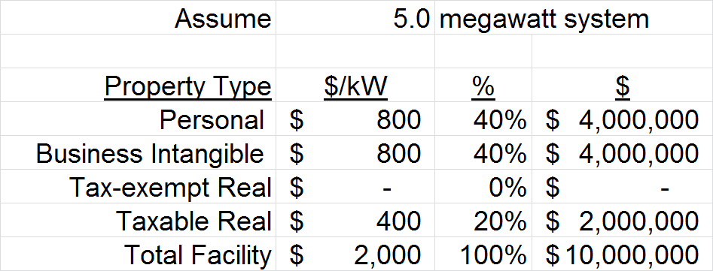
Example of Allocation, Solar Farm

Slide 24
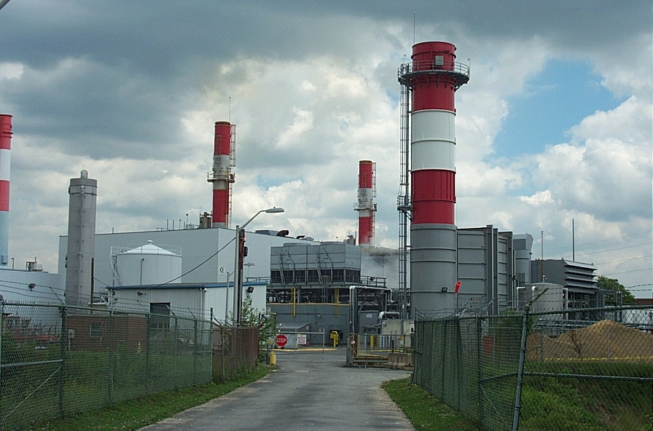
What’s taxable and what’s not?
How does one answer these questions
Get legal counsel
Get engineering counsel
Back to Basics
Establish Appraisal Problem
Define Appraisal Scope of Work

Slide 25
Sales Approach
Only problems
No/few sales
Sales will be of whole facility, not just taxable property portions
Sales will reflect income tax conditions of sale, which as a practical matter are too complex to adjust for.
Sales subject to numerous contracts for energy offtake (PPAs) and for service and supply, which are usually confidential

Slide 26
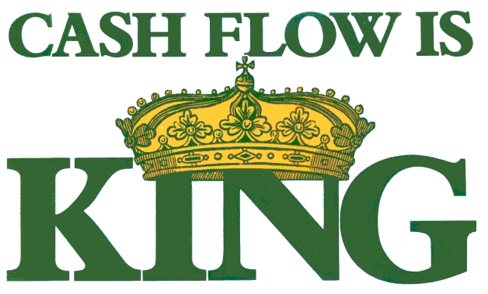
Income Approach
Cash is King
All Businesses Produce the Same Thing: CASH!
AKA: Income or Cash Flow
Thus, The Income Approach is King
Slide 26

Slide 27
The “Mojo” Income Approach
The DCF is the Big Daddy
Little Brother, Direct Cap
Not Forgotten
Still useful as cross-check
Sometimes sufficient by itself
Appropriate for regulated assets
But courts in NJ don’t like the DCF
Slide 27

Slide 28
Holding Periods & Reversions
Technology Has A More Discrete Life Than Real Estate
License Expirations Can Set Limits On Useful Lives
Major Contracts
PPA’s
Tolling Arrangements
Exemptions, Abatements and Credits have limited lives
Slide 28

Slide 29
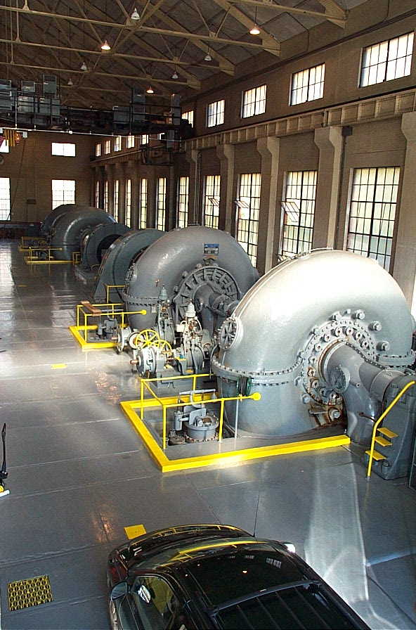
Gross Income
Find and Analyze All Sources of Gross Income
Generation Sales
Capacity factors
Capacity Sales
Steam, Fuel Resales
Tax Credits
Renewable Energy Credits
Slide 29

Slide 30
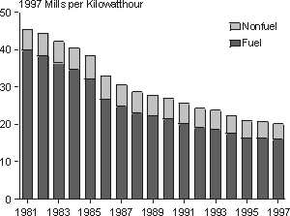
Operating & Capital Expenses
Actual History vs. Market Data
Sources and Reliability
Relicensing Fees
Decommissioning Funds
Slide 30

Slide 31
The Secret Ingredient:
The Rate
Discount Rates
The Cook Book, Ibbotson’s
Korpacz
Other Formulaic Methods
Capitalization Rates
Reversion Capitalization Rates
Slide 31

Slide 32
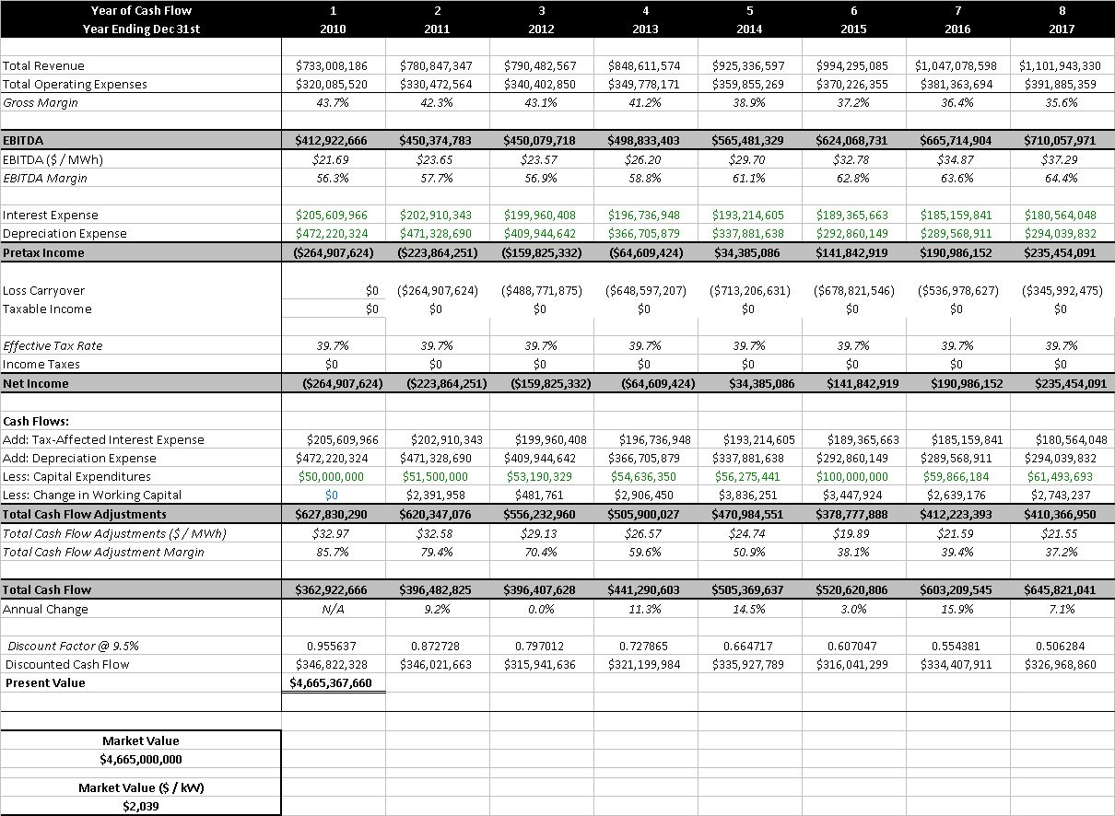

Slide 33
Income Approach
Advantage
It yields true market value
Is the only method to isolate the value of incentives
Do with and without incentives DCFs
Disadvantage
It yields the true market value of the going concern, which is a business combination of assets, including non-taxable property
The biz value must be allocated down to taxable property, or
Residual techniques must be applied to find taxable property.

Slide 34
Cost Approach
Collection of Data
Survey & Inventory – Marshall Valuation Service, RS Means
Historical Cost Information, Placed-In-Service Dates – Needed for reproduction cost new (trended original cost method)
A properly performed Cost Approach is primary supportable and defendable way to arrive at a ratio between real and personal property. If necessary, these ratios could then be applied to the business enterprise values obtained via the income approach or sales comparison approach.
Different States = Different Laws
Sale prices reported by the media are not always the taxable value
Certain liabilities and intangible assets included in the sale price
Appraisal reports are typically not applicable for multiple uses

Slide 35
Cost Approach
It works in NJ
Techniques:
Trended Original Cost
Cost per Capacity
Alternative Technology

Slide 36
Cost Approach - Advantages
Advantages TOC Cost/Cap Alt Tech
Evaluates part of plant Yes No, only No, only
(just taxable property) Whole Plant Whole Plant
Useful for Allocation Yes No No
(needed to utilize Income or Sales Approach)
Useful to Estimate Functional and/or
Economic Obsolescence Yes Yes Yes
(needed to complete Cost Approach)

Slide 37
Cost Approach - Disadvantages
Getting only the taxable property when using some techniques
Getting a credible functional and/or economic obsolescence adjustment
Cost does not equal value
Until all three forms of depreciation are fully accounted for
To get all forms, must account for the incentives

Slide 38
Why Incentives Matter
Because without them, many power plants are not financially feasible and are not maximally productive
Because without them, many power plants suffer massive economic and/or functional obsolescence

Slide 39
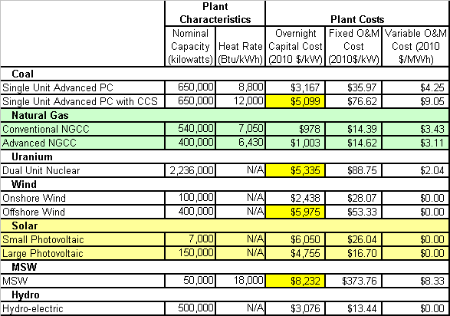
Why Incentives Matter

Slide 40
Why Incentives Matter
Solar competitive advantages
Very low operating costs
Distributed and retail energy
Solar competitive disadvantages
Very high construction costs
Very low capacity factor, at 15%
(nuclear and coal at >90%, natural gas at 75%, wind at 30%)
Can not chose when to generate
On balance, Solar does not compete without them, today.

Slide 41
Why Incentives Matter

Slide 42
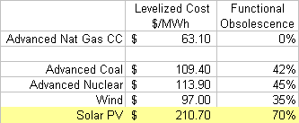
Solar PV Functional Obsolescence From Levelized Cost Analysis

Slide 43
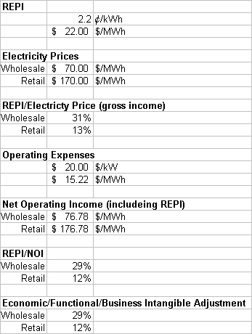
Renewable Energy Production Incentive (REPI)

Slide 44
How to account for the incentives?
Depends on your approach/technique
Cost
Income analysis of benefits of incentives,
A with and without analysis
Alternative technology
Excess Capital Costs
Income
Analysis with and with out the benefits of incentives

Slide 45
Example Steps in Cost Value
Define taxable components of whole facility
Develop cost new of components
Deduct physical depreciation
Estimate functional/economic obsolescence, using either:
Alternative technology technique
Income shortfall method
Estimate value of incentives and allocate their value, as an obsolescence, to taxable property.
Compute market value of taxable property

Slide 46
Example Two, Hotel
Assets change hands frequently
Difficult to find historical construction costs
Take-offs and Inventory – Get a count of what is there
Replacement Cost – MVS & RS Means
Depreciation Analysis and Conclusion of Fair Value
Segregation of Real vs. Personal Property vs. Business Intangibles

Slide 47
Borgata Decision

Slide 48
Income Approach
“Most Credible”
“Cost Approach not always credible – but sometimes is credible”
Even though that’s what old rulings implied is needed for casinos, cost approach is not best in this case.

Slide 49
View Value from:
“Perspective of participants”
“Considering future expectations & predictions”
What do participants think they are buying
“Going concern, enterprise”
“Not merely real property”
“Muni’s appraiser stayed too local, not examining the real breadth of the market which included Pennsylvania. Muni’s appraiser did not fully account for factors affecting future revenue, namely a new permanently lower income at the AC casinos.”

Slide 50
Income Approach
Was employed by all three appraisers
Most indicative/probative of value
Accepted by Judge
Income approach yielded a Going Concern Value, not a real property value.
But that’s OK . . . to start with.
Accepted by Judge
All three appraisers then conducted a residual analysis to find the real property value.
Going Concern value – business intangibles value – personal property value = real property value
Accepted by Judge
All three did direct cap. One also did DCF.

Slide 51
Definition of Income and Capitalization Rate
EBITDA
“Property’s income need not be from leases and rents”
“Before income tax”
Added back ground lease expense
Rushmore business management expense added in
Cap Rate
Two owner’s appraisers derived by extraction and conversion of EBITDA multipliers taken from casino sales comps.
Judge accepted cap rate method of converting EBITDA multipliers
Adjusted to reflect risk of owning a single asset
Muni’s appraiser utilized Korpacz hotel rates.
Judge did not accept Korpacz as indicative/probative.
DCF used by one appraiser. No reaction by Judge on DCF.

Slide 52
Personal Property Value
Depreciated Value
Book Value
This is not the best technique from perspective of common, best, or state of the art appraisal practices
Added in share of soft costs and finance costs – Allocation Technique

Slide 53
Alternative Personal Property Methods
For future cases – ought to use common, best, or state of the art appraisal practices
Numerous variations of the three approaches to value
Sales
Cost
Income
All well documented in appraisal theory and texts
Many commonly accepted in other practice areas
Banking and Finance
Regulatory
Courts

Slide 54
Business Intangibles
“Equals Rushmore Business Management Expense”
Two owner’s appraisers made Rushmore adjustment. Muni’s appraiser did not
Judge ruled Rushmore adjustment was needed

Slide 55
Rushmore Business Management Expense
Basic Notion: All Business Intangibles = Rushmore Business Management Expense
Judge’s theory: If a property owner hires a business management firm to run the business at the property, then the property owner is only left with the task of managing the real property. If the expense of the business management firm is deducted from the business income at the property, then the property owner is left strictly with the income to the real property. An analysis of the remaining income will yield a value of the real estate.

Slide 56
Issues with Rushmore Business Management Expense
Basic Notion is
Only true in some circumstance
May not be exhaustive
Hard to estimate; Hard to find supporting market data
If idea is applicable to hotels and casinos, then applicable to all properties integrated into a business
Theaters, race tracks
Restaurants, resorts
Power plants, utilities, infrastructure
Some senior housing
Hospitals
And maybe also much general commercial real estate

Slide 57
Alternatives to Rushmore Business Management Expense
Various alternatives exist
Others are well established in other valuation theory and practices
Others are frequently used in IRS and SEC reporting
RBME is only used in New Jersey
RBME is not in major appraisal texts
Unless you re-label it
Excess Earnings Method, slide 14
With and Without Method, slide 15

Slide 58
Cost Approach
One appraiser did not do it
One did it reluctantly under orders of the attorney
Attorney ordered it because of interpretation of earlier ruling that opined casino appraisals must use cost
Appraiser gave it no weight
One gave it significant weight
Judge did not believe cost was needed or indicative/probative in this appraisal
The issue with cost was estimating economic obsolescence

Slide 59
Professional Assistance to Appraiser
One appraiser utilized supporting professional reports/opinions,
Economics Professor
Accepted by Judge

Slide 60
Sales Approach
No good comparables
Only distressed sales
Not comparable
Different locations
Judge agreed with appraisers
Sales approach is not indicative/probative

Slide 61
Two Appraisal Blunders
Muni’s Appraiser admitted to averaging
And not weighting or adjusting or emphasizing/de-emphasizing some of the historical data.
Judge correctly ruled this is not good appraisal
Appraisers must account for trends contraindicated by averages
Muni’s appraiser utilized data from after the appraisal date
Wrongly defined stabilizing as averaging and utilizing data from after appraisal date
Judge correctly ruled this is not good appraisal

Slide 62
Judge’s Approach:
“Consider but not require all three appraisal approaches
Do not assume old rulings or standard appraisal texts mandate inclusion or exclusion of one or more approaches.
Despite the appraisal theory texts and rulings on importance and utility of sales and cost approaches, Judge agrees with appraisers sales and cost approaches are not credible, not needed, in this case.
Even if casinos are thought of as special purpose properties, where the cost approach may be indicated, income is best because of issue of estimating economic obsolescence.”

Slide 63
Courts’ Prerogative
Courts may depart from appraisal’s prescriptions
But courts appear to prefer to accept the consensus of the appraisers.
However admonished appraisers for not allowing the Judges to decide what approaches should be excluded.
Moral may be to include data on excluded approach that indicates that no weight should be given to the approach.
Appraisers ought to explain why an approach is excluded and ought not to simply state its exclusion was stipulated to, thus allowing the Judge to concur or not with the appraisal opinion to exclude all weight.
Include but give no weight.

Slide 64
Ruling is remarkably good appraisal work
E.G.: “suffice to hold” while old rulings and some appraisal theory indicate the cost is best, income is better in this case.
Except one point: “the income approach to valuation has been traditionally applied to real property that generates rental income.”
This is real estate-centric - Business and personal property appraisal utilize income approaches also, and there is no rental income there.

Slide 65
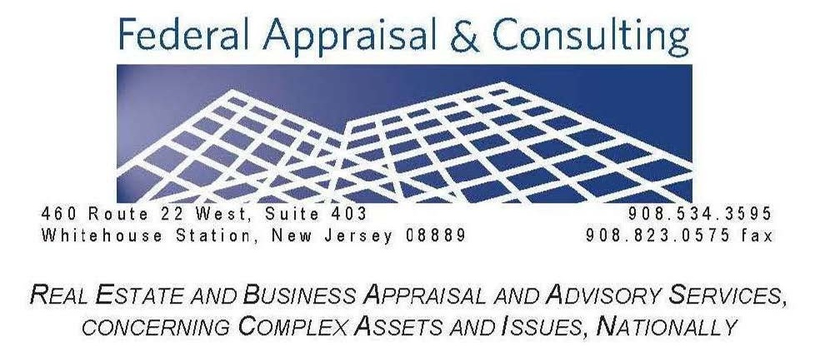
Questions
Mark Pomykacz
Mark@FederalAppraisal.com

